Slide 1
POSGCD Monitoring Report
GMA 12 Joint Planning and Compliance
GMA 12 Meeting – Milano, TX
December 17, 2015

Slide 2
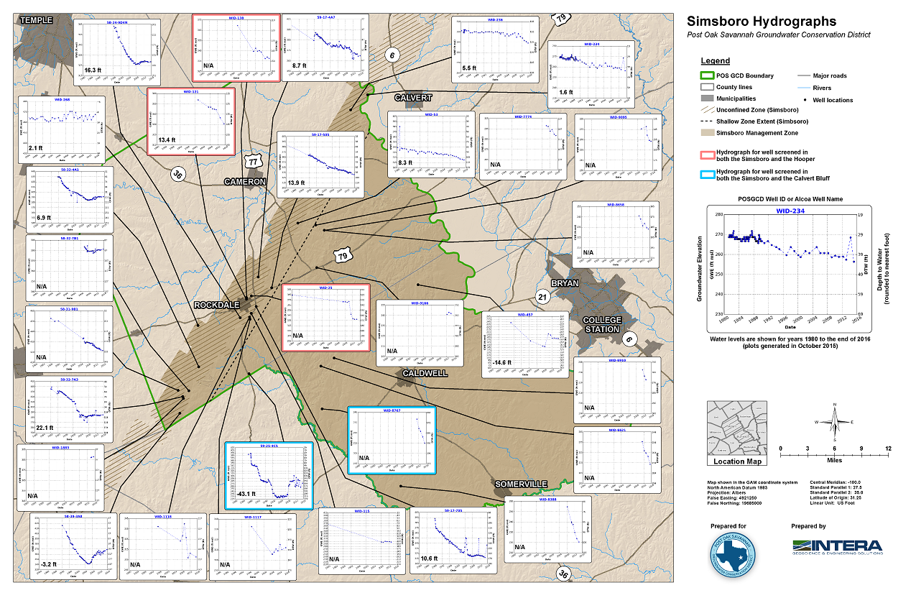
Hydrographs: Simsboro Example

Slide 3
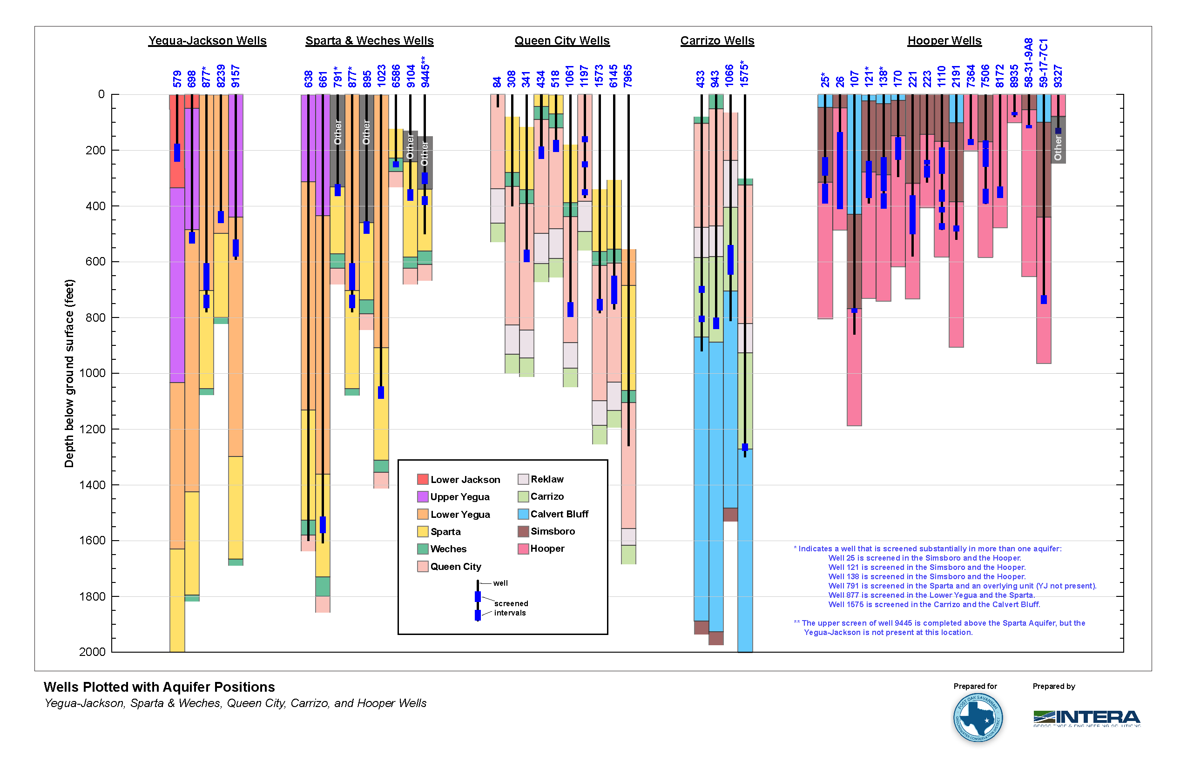
Sparta, Queen City, Carrizo, Hooper, and Yegua-Jackson Wells

Slide 4
Comparison Between DFC and Calculated Average Drawdown
Aquifer | Management Zone | Desired Future Condition Average¹ | Number of Wells with Three-year Average |  |  |  | Average Based on Measured Water Levels in Same Wells in POSGCD from 2000 to 2012 |  |  |  | Average Based on Interpolated Points |  | DFC Compliant⁴ | Percent of Average Drawdown of DFC⁵
 |  |  |  |  |  |  | Number of Wells | Straight Average | Group by Cluster | Four Zones in Shallow | All 2000 Wells and All 2012 Wells | Only Wells Common to 2000 and 2012²
 |  |  | 2000 |  | 2012
 |  |  | POSGCD | All | POSGCD | All
Sparta | Shallow | 10 | 0 |  | 0 |  | 0 | na | na | na | 22.2 | 3.6 | yes | 36.0%
 | Entire | 30 | 3 | 12 | 6 | 27 | 3 | 4.6 | 4.6 |  | 33.6 | 3.5 | yes | 11.7%
Queen City | Shallow | 10 | 4 |  | 5 |  | 4 | 2.5 | 3.0 | 3 | 12 | 3.1 | yes | 31.0%
 | Entire | 30 | 5 | 12 | 9 | 24 | 5 | 2.8 | 3.2 |  | 17.3 | 3.1 | yes | 10.3%
Carrizo | Shallow | 20 | 0 |  | 1 |  | 0 | na | na | na | 7.7 | 6.5 | yes | 32.5%
 | Entire | 65 | 1 | 7 | 4 | 11 | 1 | 10.1 | 10.1 |  | 33.9 | 6.7 | yes | 10.3%
Calvert Bluff (Upper Wilcox) | Shallow | 20 | 8 |  | 17 |  | 7 | 9.2 | 9.1 | 11.2 | -11.1 | 0 | yes | 0.0%
 | Entire | 140 | 11 | 18 | 20 | 33 | 11 | -1.7 | -7.5 |  | -6 | -11.4 | yes | -8.1%
Simsboro (Middle Wilcox) | Shallow | 20 | 12 |  | 19 |  | 12 | 8.9 | 7.8 | 6 | 12 | 9.6 | yes | 48.0%
 | Entire | 300 | 14 | 31 | 29 | 71 | 14 | 3.5 | -0.4 |  | 20.3 | 11.1 | yes | 3.7%
Hooper (Lower Wilcox) | Shallow | 20 | 4 |  | 9 |  | 4 | 5.9 | 5.9 | 5.6 | 40 | 6.2 | yes | 31.0%
 | Entire | 180 | 5 | 6 | 11 | 25 | 5 | 7.4 | 7.4 |  | 84.5 | 7.1 | yes | 3.9%
Yegua Jackson | Shallow | 15 | 0 |  | 0 |  | 0 | na | na | na | na | na | unknown | unknown
 | Entire | 100 | 1 | 9 | 4 | 27 | 1 | 7.3 | 7.3 |  | 12.3 | 16.4 | yes | 16.4%
Brazos River Alluvium | Milam | 5 |  |  |  |  | 0 | na |  |  |  |  | unknown | unknown
 | Burleson³ | 6 |  |  |  |  | 7 | 4.5 | 5.0 | 5.1 |  |  | yes | 81.1%
 | ¹ all DFCs are from Jan. 2000 to Dec. 2059 except the BRAA DFC, which is from Jan. 2010 to Dec. 2059
 | ² best estimate of calculated average drawdown from 2000 to 2012
 | ³ number of wells from 2010 to 2014
 | ⁴ likely is based on review of all available data; insuff. data requires additional information
 | ⁵ Threshold Level 1 criteria is 60%

Slide 5
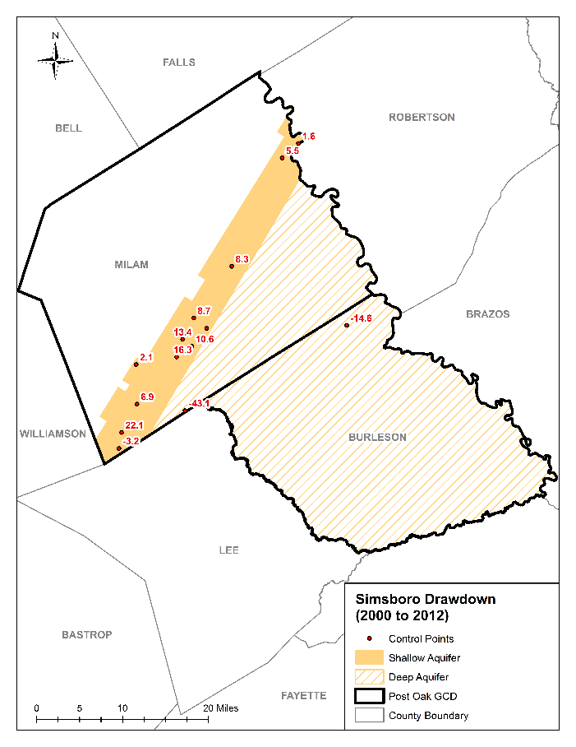
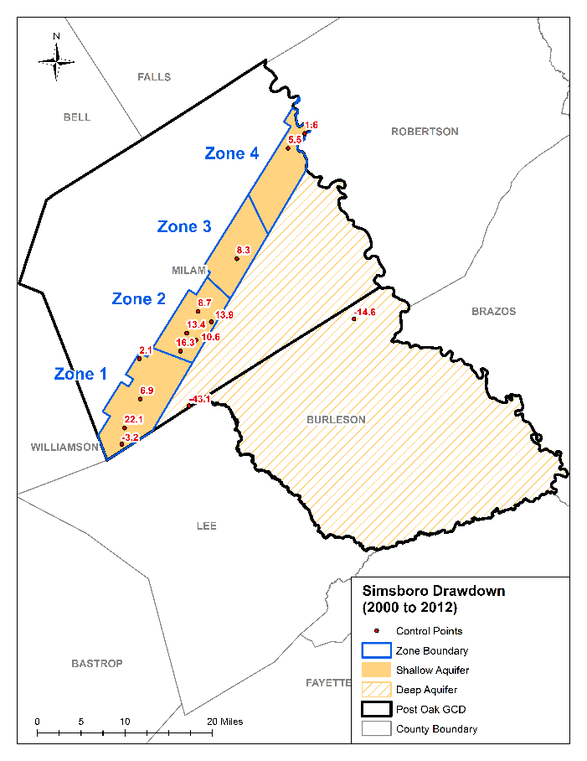
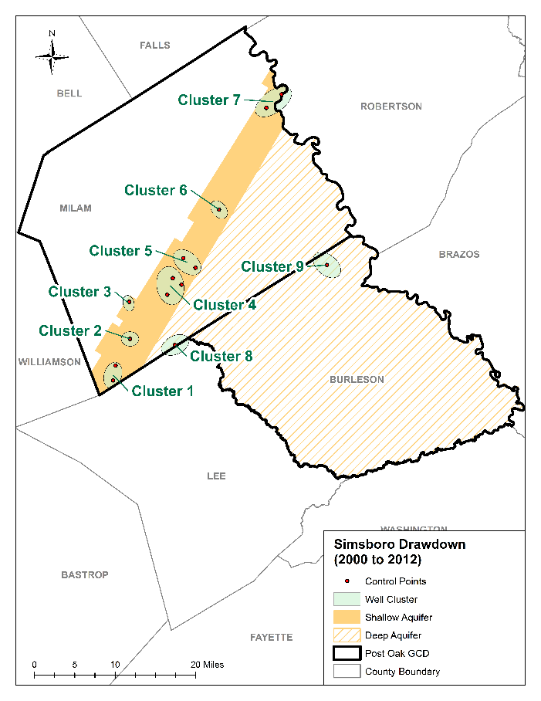
Averaging of Single Points: Simsboro
Straight Average (shallow: 8.9 ft, entire 3.5 ft)
Four Zones in Shallow (shallow: 6 ft)
Group by Cluster (shallow: 8.6 ft, entire: 1.8)

Slide 6
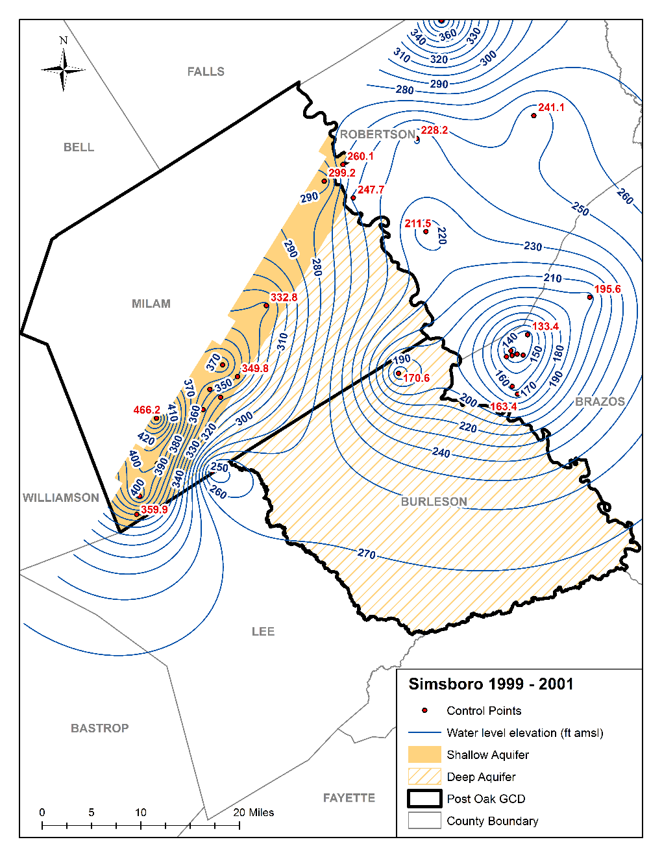
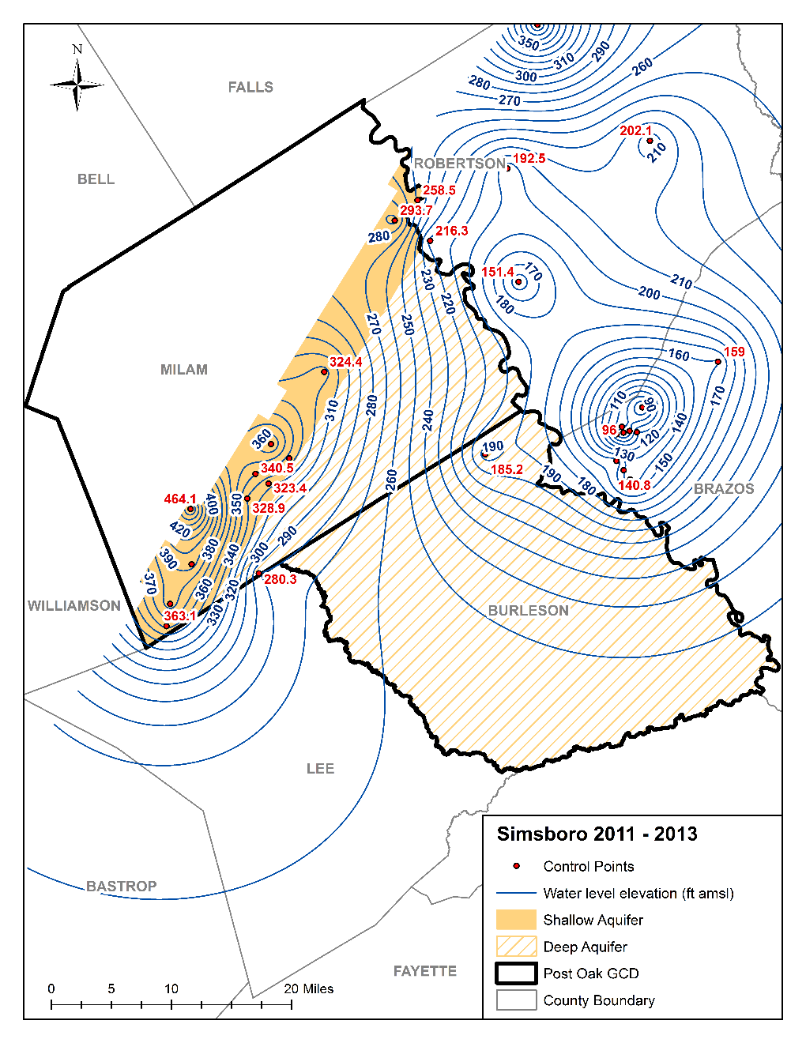
Interpolating Values Across Areas: Simsboro (same wells in 2000 and in 2012)

Slide 7
Discussion Topics: Analysis Methods
Interim Results
Multiple analysis methods are recommended
Use of Adjacent GCD data is recommended
Advantages and Disadvantages to all analysis methods
Sources of Uncertainty/Error
Localized impacts of pumping are ignored with current methods
Partially penetrating wells (do not intersect the full aquifer)
Shallow Sparta (1 wells)
Possible improvements
Zones for points guided from model results and pumping distributions
“Smart” contouring programs that accounts for groundwater flow and pumping

Slide 8
Discussion Topics: Monitoring Locations
No Coverage
Milam Brazos River Alluvium
Shallow Yegua Jackson
Sparse Coverage
Shallow Carrizo (1 well)
Entire Carrizo (4 wells)
Shallow Sparta (1 wells)
Additional Coverage
Down-dip or Deep Areas
Southwest of Bryan/College Station

