Slide 1
What’s GAMs got to do with DFC/MAGs
Cindy Ridgeway, P.G.
Contract Manager and Manager
Groundwater Availability Modeling
Texas Water Development Board

Slide 2
Disclaimer
The following presentation is based upon professional research and analysis within the scope of the Texas Water Development Board’s statutory responsibilities and priorities but, unless specifically noted, does not necessarily reflect official Board positions or decisions.

Slide 3
Agenda
Introduction to Groundwater Availability Modeling (GAM) Program.
Updates to regional model for Carrizo-Wilcox, Queen City, and Sparta aquifers
Feasibility of using models to evaluate DFCs
Monitoring DFCs

Slide 4
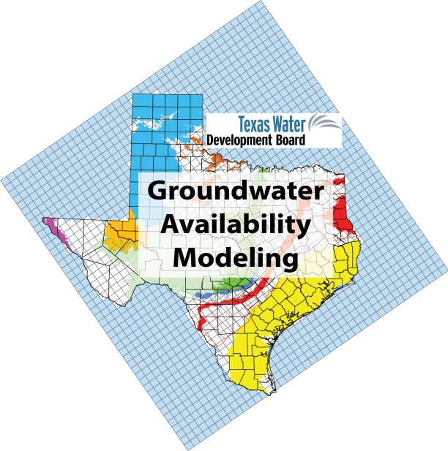
Groundwater Availability Modeling (GAM) Program

Slide 5
GAM Program
Aim: Produce groundwater flow models for the major and minor aquifers of Texas.
Purpose: Develop various tools that can be used to aid in groundwater resources management by stakeholders.
Public process: Stakeholder involvement during model development process and during associated aquifer related projects-as applicable.
Models: Freely available, standardized, thoroughly documented. Reports available over the internet.
Living tools: Periodically updated.

Slide 6
How we use Groundwater Models?
Per Statute:
Groundwater management areas can use to assist in determining desired future conditions.
TWDB uses when calculating estimated Modeled Available Groundwater.
TWDB uses when calculating Total Estimated Recoverable Storage.
TWDB provides groundwater conservation districts with water budget data for their management plans.

Slide 7
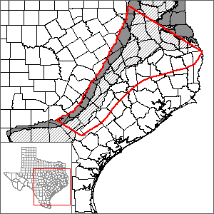
Updates to regional model for Carrizo-Wilcox, Queen City, and Sparta aquifers

Slide 8
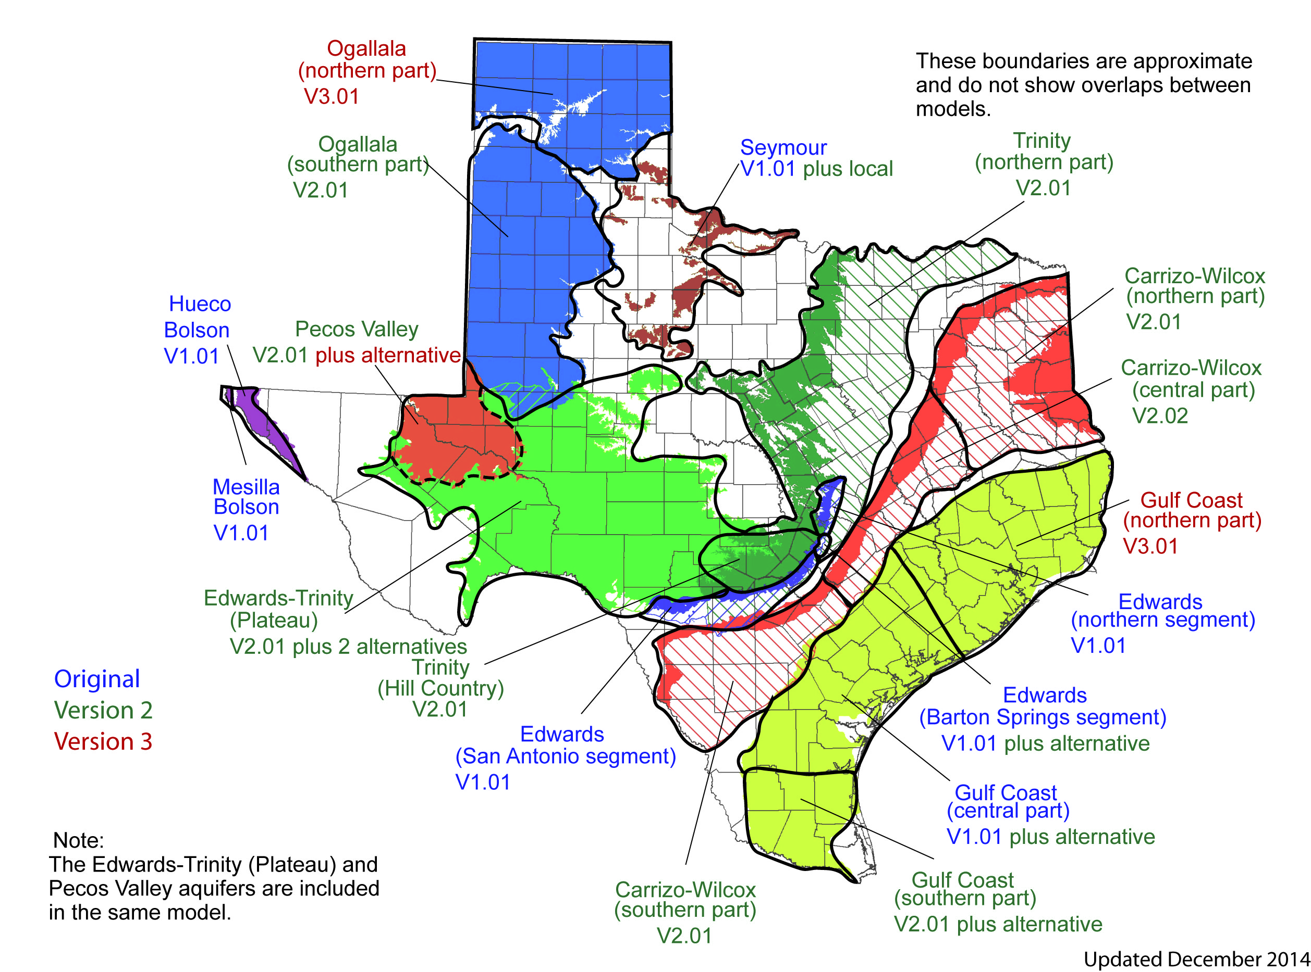
Major Aquifers
Notes:
All major aquifers in Texas are included in existing models
Some have been updated multiple times

Slide 9
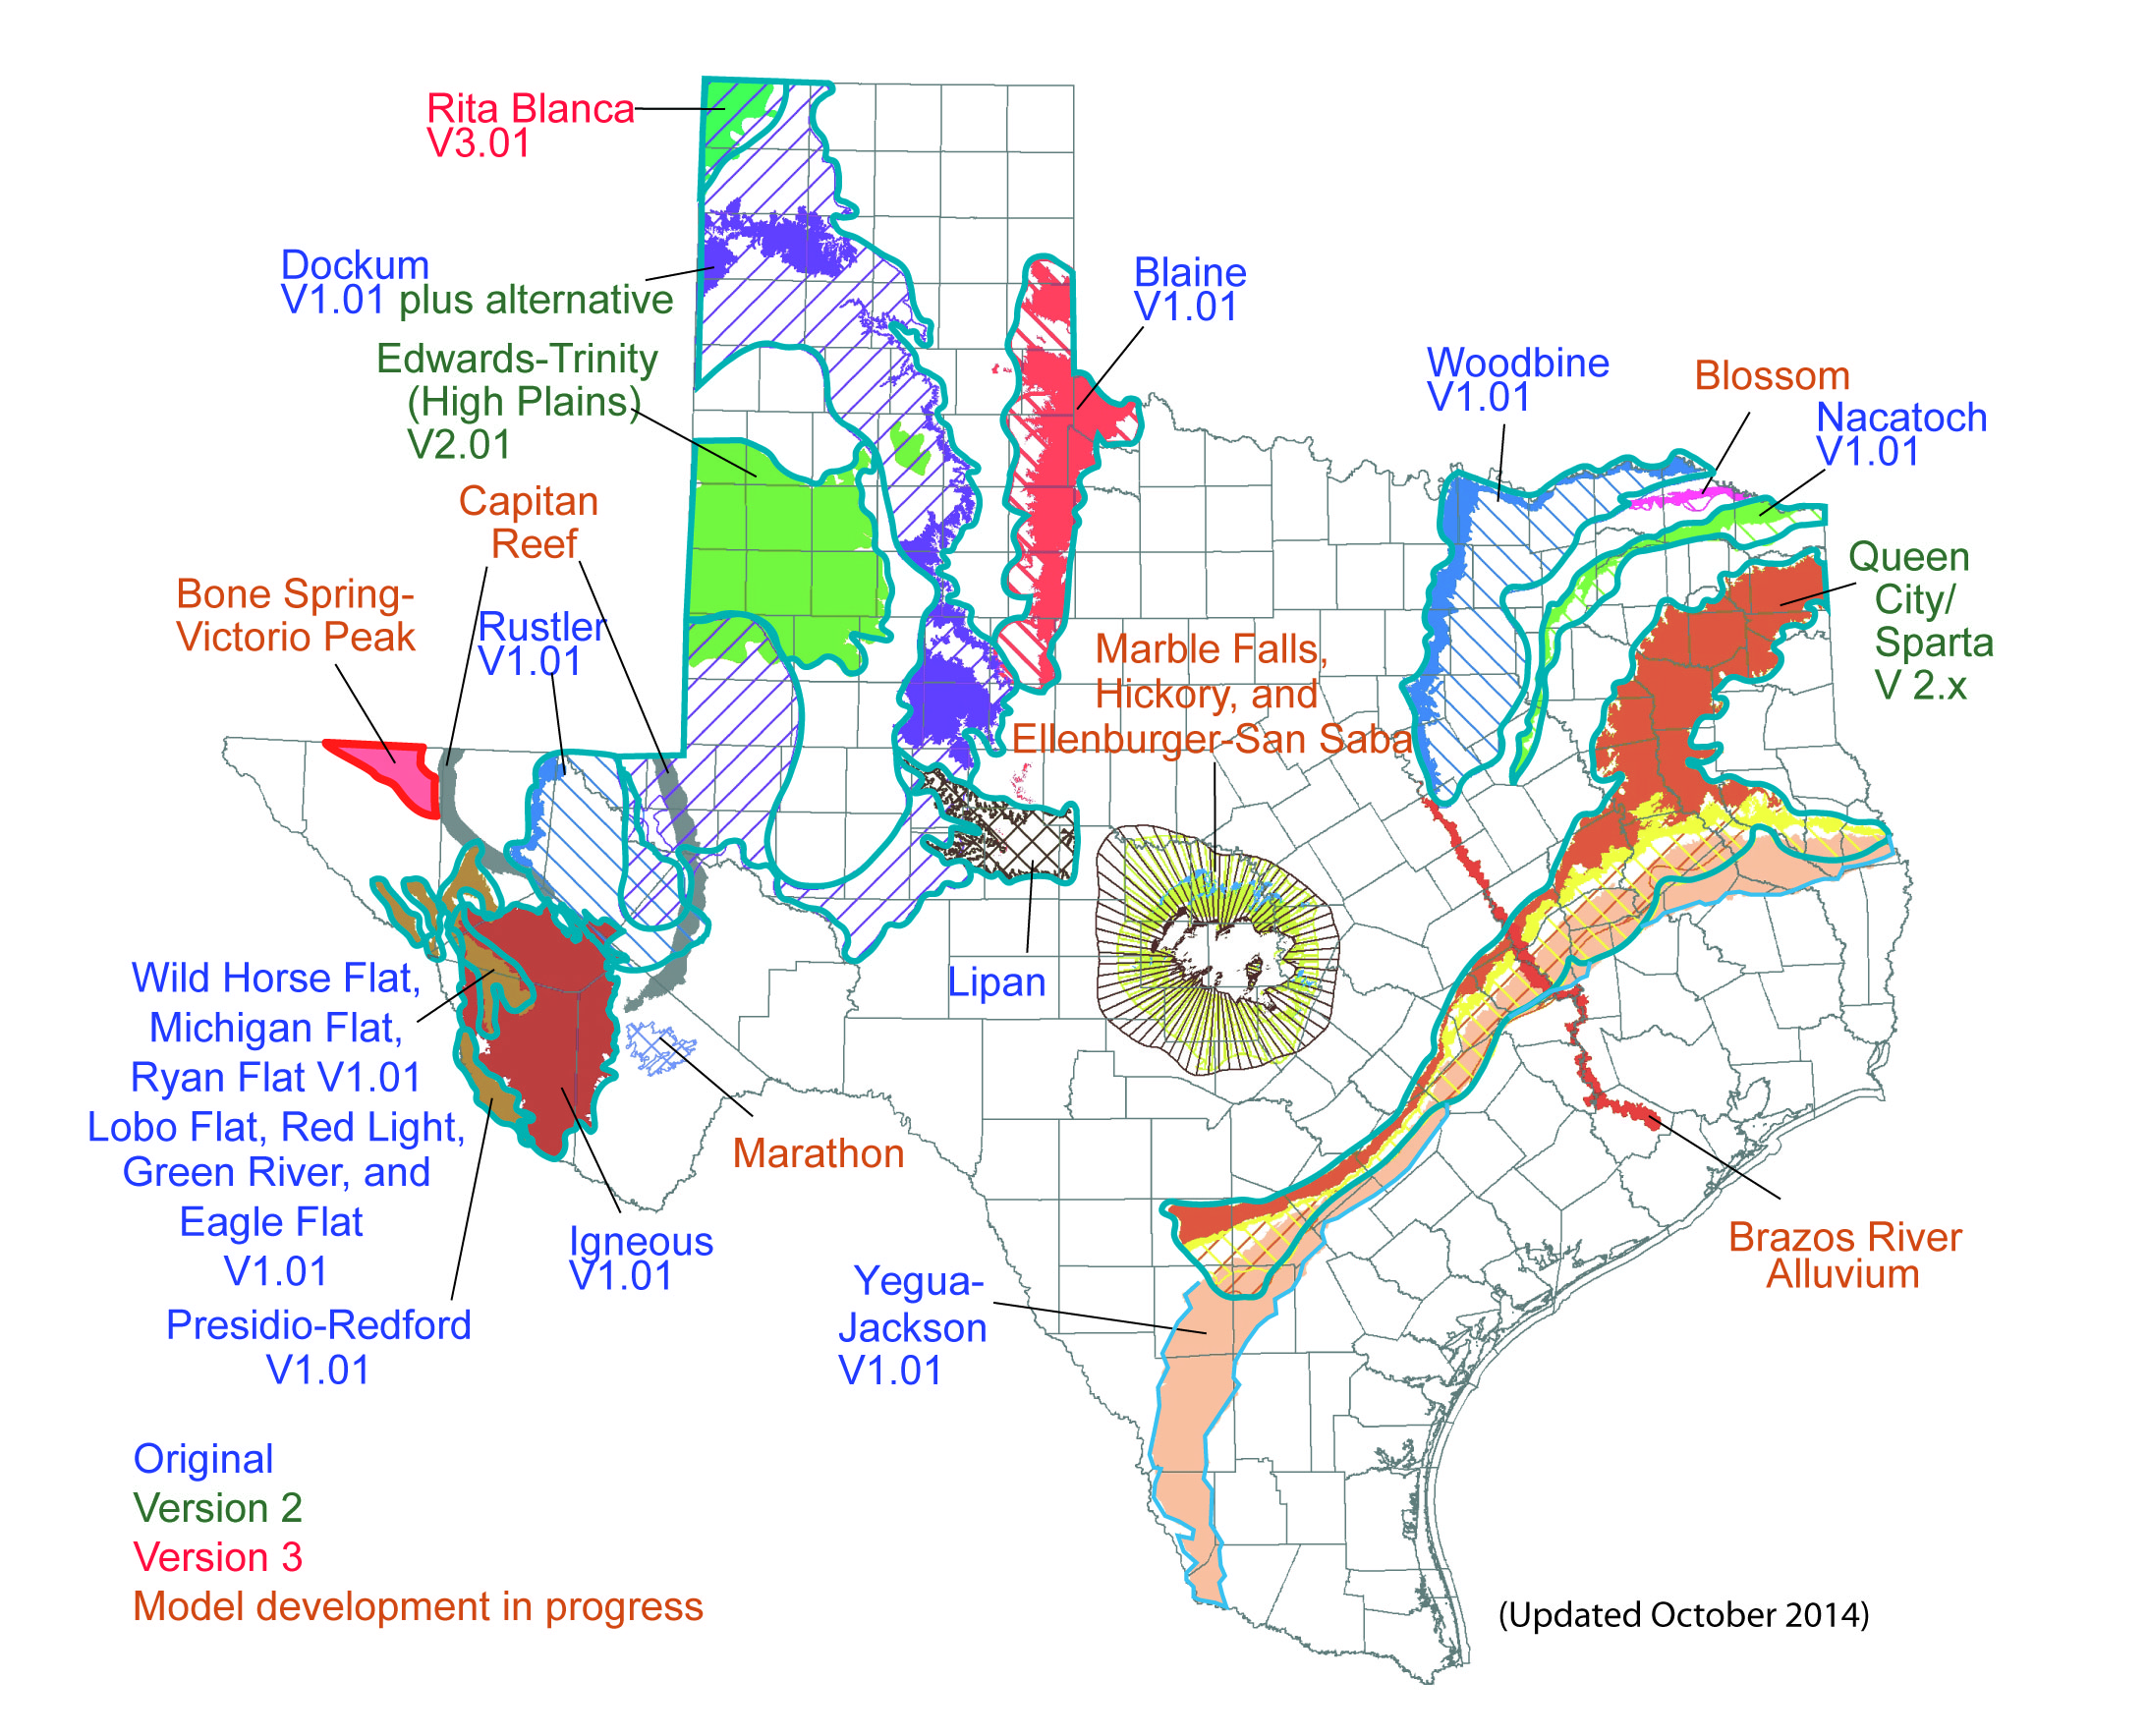
Minor Aquifers
Notes:
All minor aquifers except the Marathon Aquifer are included in existing models or models currently under construction
We are currently working on models for the
Capitan Reef Complex
Blossom
Llano uplift aquifers
Brazos River Alluvium

Slide 10
Scope of Work (SOW)
Fault Study:
Are fault conduits or barriers to groundwater flow? Which faults should be included?
Run multiple sensitivity analyses under various stress conditions to test fault properties and their effects on the groundwater flow system in model.
Findings will be compared to aquifer test data and other water level data.
If needed, update model.
Update historical pumping in model
Bring model up to at least 2010
Update model with information from BRACS analysis (structure and aquifer properties)

Slide 11
Proposed update to Scope of Work
Summarized proposed additional SOW
upgrades to the modeling code (gridding),
refinements to the model’s capacity to reflect the dynamics of groundwater-surface water interactions, and
task to re-investigate the application of recharge from precipitation to the groundwater flow system.
Received Board approval to proceed (December 14, 2015)
Contracts to be completed by March 31, 2016

Slide 12
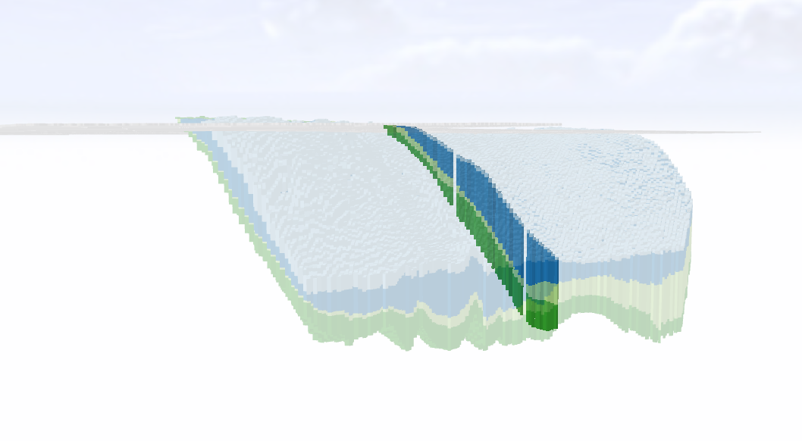
Feasibility of using a model to evaluate DFCs

Slide 13
GAMs and DFCs
GAMs provide regional answers. They provide the “big picture” of effects of pumping on aquifer
Not designed to match measured values for individual well
Predictive pumping volumes and placement of pumping based on assumptions
They are tools to help with groundwater management
Many Districts use range/bracket

Slide 14
Going from DFCs to MAGs
The modeled available groundwater is the amount of groundwater pumping that will achieve the desired future condition(s).
The modeled available groundwater will be provided to GCDs and regional water planning groups.
Regional planning groups express their planning efforts in 10-year increments extending 50 years in the future (2070 for next planning cycle).

Slide 15
Going from DFCs to MAGs (cont.)
While not specified by law, we recommend that the desired future conditions statement carefully express the best available knowledge of future groundwater pumping (at 10 years intervals) to assist regional water planning groups in their projects.
Please carefully consult the presentation at:
http://www.twdb.texas.gov/groundwater/docs/How_to_Do_a_MAG_05_2014.pdf

Slide 16
What MAG you get may depend on what you provide….
Modeled available groundwater calculations are associated with a specific MODFLOW well file.
It is preferred that desired future conditions submittals include the MODFLOW well file which achieves the desired future condition.
If no well file is submitted, the TWDB groundwater availability modeling staff will develop the well file.

Slide 17
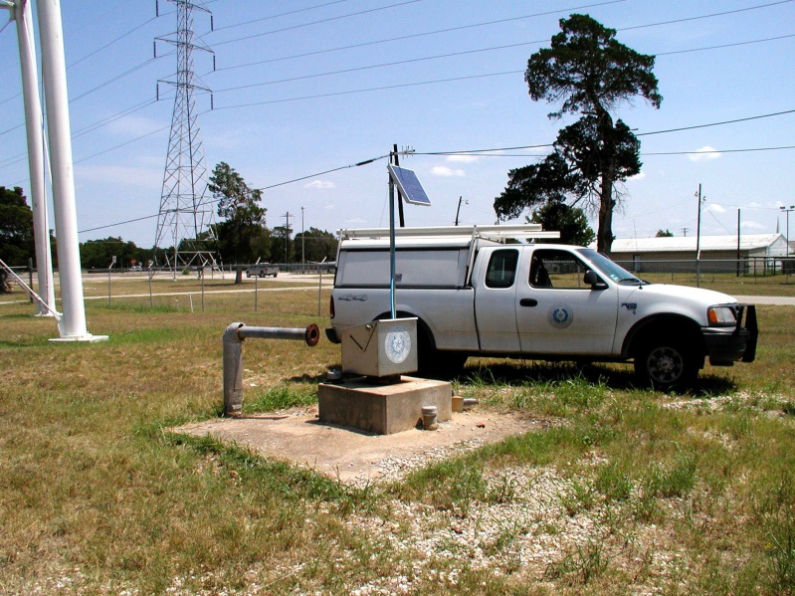
Monitoring DFCs

Slide 18
DFC Monitoring
Modeled Available Groundwater (MAGs) are to be considered when permitting
Monitoring the aquifer determines if you are achieving DFCs (or not)

Slide 19
Contact Information
Cindy Ridgeway, P.G.
Groundwater Availability Modeling Section
512-936-2386
Cindy.ridgeway@twdb.texas.gov
Texas Water Development Board
P.O. Box 13231
Austin, Texas 78711-3231
Web information:
http://www.twdb.texas.gov/groundwater/models/gam/czwx_c/czwx_c.asp

