Slide 1
Status Report of Groundwater Modeling Results
Presented to:
Groundwater Management Area 12
December 17, 2015
Prepared by:
GMA 12 Consultants

Slide 2
Sparta, Queen City, and Carrizo-Wilcox

Slide 3
Predictive Scenario 5 Central Queen City-Sparta GAM
Updated GMA12-7B Well File used for Current DFCs
Historical Pumping from 2000 to 2010 Updated
Some Predictive Pumping Updated
Compare Results of Average Drawdowns for 2060 versus 2070

Slide 4
Current Year 2060 MAGs (Acre-Feet)
District | Brazos River Alluvium | Sparta | Queen City | Carrizo | Calvert Bluff | Simsboro | Hooper | Total
Brazos Valley | - | 7,923 | 529 | 5,496 | 1,755 | 96,185 | 316 | 112,204
Fayette County | - | 3,729 | 570 | 1,000 | - | - | - | 5,299
Lost Pines | - | 1,877 | 1,133 | 12,052 | 3,985 | 37,249 | 2,592 | 58,888
Mid-East Texas | - | 3,334 | 974 | 11,088 | 3,912 | 7,170 | 827 | 27,305
Post Oak Savannah | 25,138 | 6,734 | 502 | 7,059 | 1,038 | 48,501 | 4,422 | 93,394
GMA 12 GCDs | - | 23,597 | 3,708 | 36,695 | 10,690 | 189,105 | 8,157 | 271,952

Slide 5
PS5 Year 2070 Pumping (Acre-Feet)
District | Sparta | Queen City | Carrizo | Calvert Bluff | Simsboro | Hooper | Total
Brazos Valley | 9,019 | 1,200 | 5,494 | 1,758 | 96,187 | 2,001 | 115,659
Fayette County | 2,802 | 2,708 | 5,474 | — | — | — | 10,984
Lost Pines | 2,405 | 1,315 | 12,052 | 3,984 | 37,249 | 2,592 | 59,597
Mid-East Texas | 3,343 | 974 | 11,091 | 3,917 | 7,181 | 835 | 27,341
Post Oak Savannah | 6,747 | 504 | 7,063 | 1,037 | 48,503 | 4,480 | 68,334
GMA 12 GCDs | 24,317 | 6,701 | 41,173 | 10,696 | 189,119 | 9,908 | 281,914

Slide 6
Difference in PS5 Year 2070 Pumping And Year 2060 MAG (Acre-Feet)
District | Sparta | Queen City | Carrizo-Wilcox
Brazos Valley | 1,096 | 671 | 1,688
Fayette County | -927 | 2,138 | 4,474
Lost Pines | 528 | 182 | -1
Mid-East Texas | 9 | 0 | 26
Post Oak Savannah | 13 | 2 | 63

Slide 7
PS5 – Sparta Pumping

Slide 8
Sparta Aquifer (Layer 1) Average Drawdown – 1/1/2000 through 12/31/2070
LPGCD
DFC: 7 Feet
PS5: 4 Feet
POSGCD
DFC: 30 Feet
PS5: 28 Feet
BVGCD
DFC: 15 Feet
PS5: 12 Feet
METGCD
DFC: 0 Feet
PS5: 1 Feet
FCGCD
DFC: 60 Feet
PS5: 47 Feet
GMA 12
PS5: 16 Feet

Slide 9
PS5 – Queen City Pumping

Slide 10
Queen City Aquifer (Layer 3) Average Drawdown – 1/1/2000 through 12/31/2070
LPGCD
DFC: 13 Feet
PS5: 16 Feet
POSGCD
DFC: 30 Feet
PS5: 30 Feet
BVGCD
DFC: 12 Feet
PS5: 12 Feet
METGCD
DFC: 0 Feet
PS5: -3 Feet
FCGCD
DFC: 60 Feet
PS5: 64 Feet
GMA 12
PS5: 16 Feet

Slide 11
PS5 – Carrizo Pumping

Slide 12
Carrizo Aquifer (Layer 5) Average Drawdown – 1/1/2000 through 12/31/2070
LPGCD
DFC: 47 Feet
PS5: 69 Feet
POSGCD
DFC: 65 Feet
PS5: 67 Feet
BVGCD
DFC: 47 Feet
PS5: 60 Feet
METGCD
DFC: 55 Feet
PS5: 80 Feet
FCGCD
DFC: 60 Feet
PS5: 110 Feet
GMA 12
PS5: 75 Feet

Slide 13
PS5 – Calvert Bluff Pumping

Slide 14
Calvert Bluff Aquifer (Layer 6) Average Drawdown – 1/1/2000 through 12/31/2070
LPGCD
DFC: 99 Feet
PS5: 110 Feet
POSGCD
DFC: 140 Feet
PS5: 149 Feet
METGCD
DFC: 70 Feet
PS5: 89 Feet
BVGCD
DFC: 106 Feet
PS5: 125 Feet
FCGCD
DFC: N/A
PS5: N/A
GMA 12
PS5: 113 Feet

Slide 15
PS5 – Simsboro Pumping

Slide 16
Simsboro Aquifer (Layer 7) Average Drawdown – 1/1/2000 through 12/31/2070
LPGCD
DFC: 237 Feet
PS5: 256 Feet
POSGCD
DFC: 300 Feet
PS5: 318 Feet
METGCD
DFC: 115 Feet
PS5: 134 Feet
BVGCD
DFC: 270 Feet
PS5: 294 Feet
FCGCD
DFC: N/A
PS5: N/A
GMA 12
PS5: 227 Feet

Slide 17
PS5 – Hooper Pumping

Slide 18
Hooper Aquifer (Layer 8) Average Drawdown – 1/1/2000 through 12/31/2070
LPGCD
DFC: 129 Feet
PS5: 184 Feet
METGCD
DFC: 95 Feet
PS5: 116 Feet
POSGCD
DFC: 180 Feet
PS5: 204 Feet
BVGCD
DFC: 170 Feet
PS5: 205 Feet
FCGCD
DFC: N/A
PS5: N/A
GMA 12
PS5: 165 Feet

Slide 19
Yegua-Jackson

Slide 20
Yegua-Jackson MAGs and DFCs for 2060
District | MAG (Acre-Feet per Year) | DFC (Average Feet of Drawdown)
Brazos Valley | 7,071 | Yegua: 70 Jackson: 110
Fayette County | 5,762 | 110
Lost Pines | N/A | N/A
Mid-East Texas | 1,122 | 5
Post Oak Savannah | 12,923 | 100
GMA 12 GCDs | 26,878

Slide 21
Yegua-Jackson Proposed Modeling
Utilize Previously Developed DFC Well File
Extend 2060 Pumping Through 2070
Review Results

Slide 22
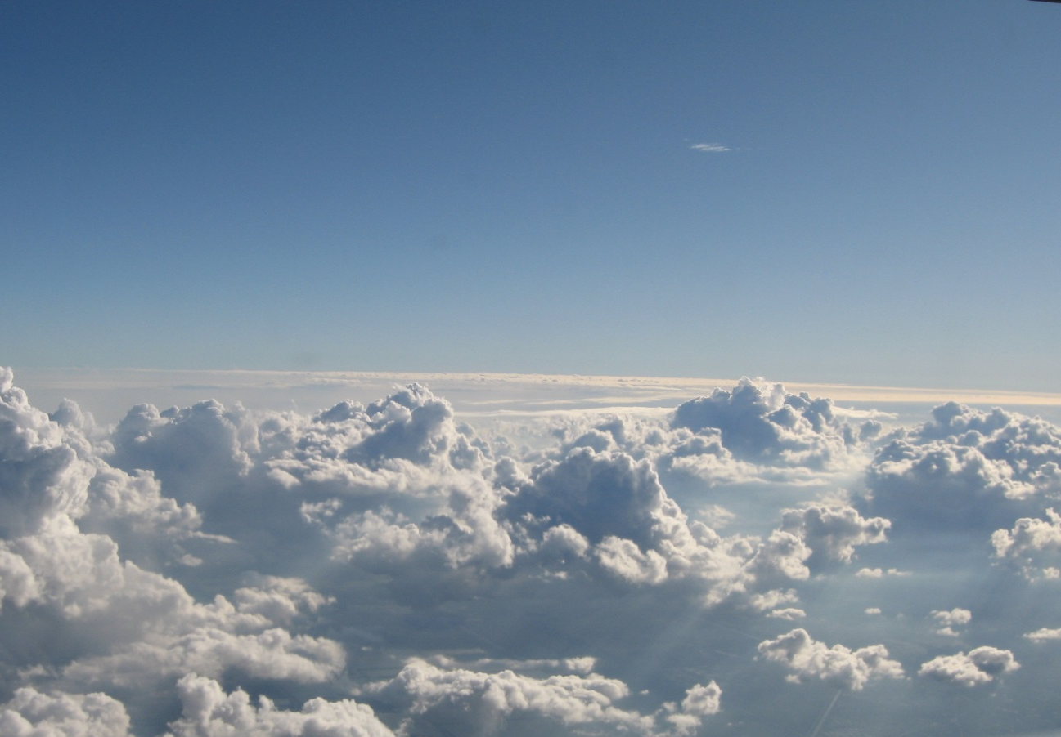
Discussion
W. John Seifert, Jr., P.E.

