Slide 1
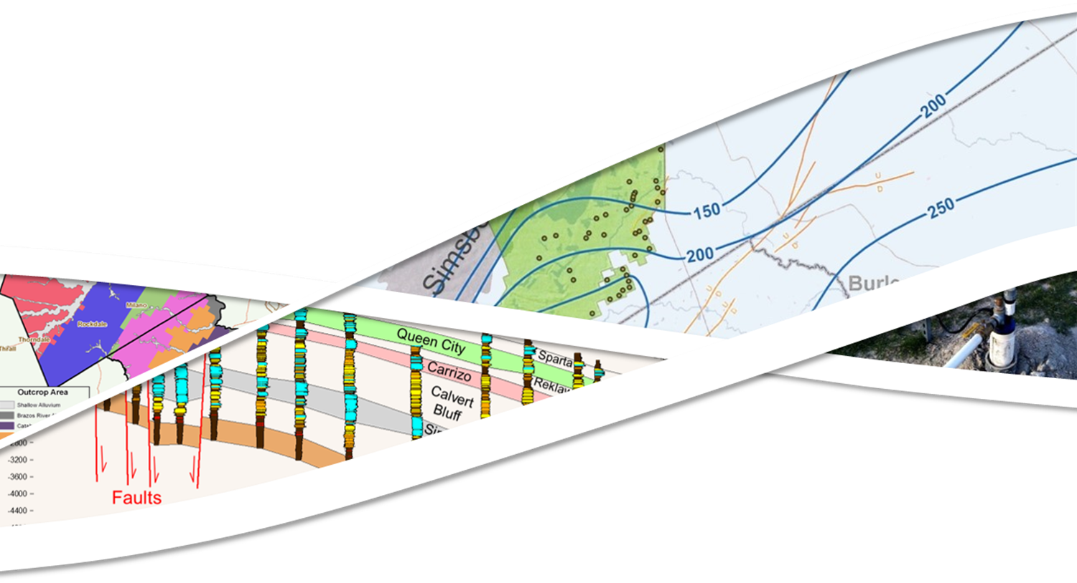


Status Update on Research Project
Presented To:
Presented By:
Steve Young
Jevon Harding
August 7, 2018

Slide 2
Outline
Surface-Water Groundwater Interactions
Aquifer Storage and Recovery

Slide 3
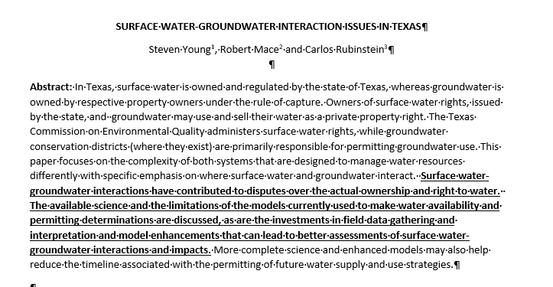
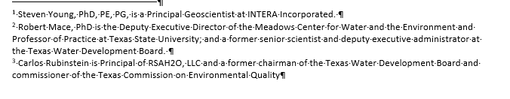
Manuscript for Texas Water Journal

Slide 4
Manuscript for Texas Water Journal: Recommended Actions
Conduct Field Studies
Vet Approaches for Calculating Baseflow Using Hydrograph Separation
Update and Improve Groundwater Availability Models
Develop Science to Better Define Baseflow, Bankflow, and Underflow

Slide 5
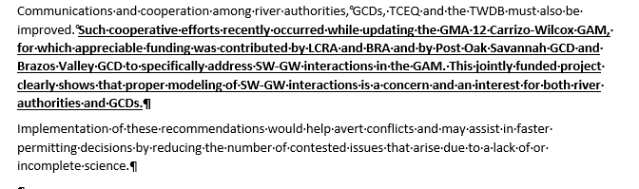
Manuscript for Texas Water Journal: Conclusions

Slide 6
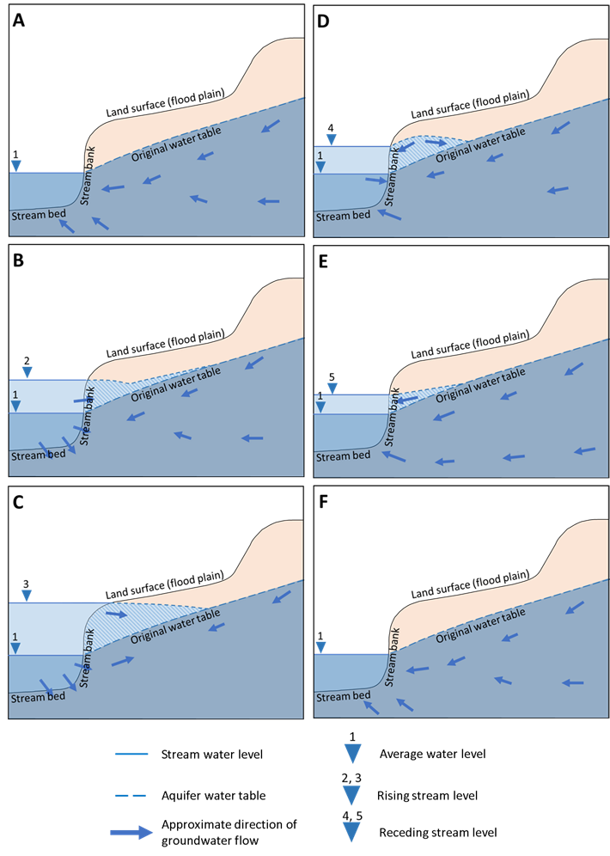
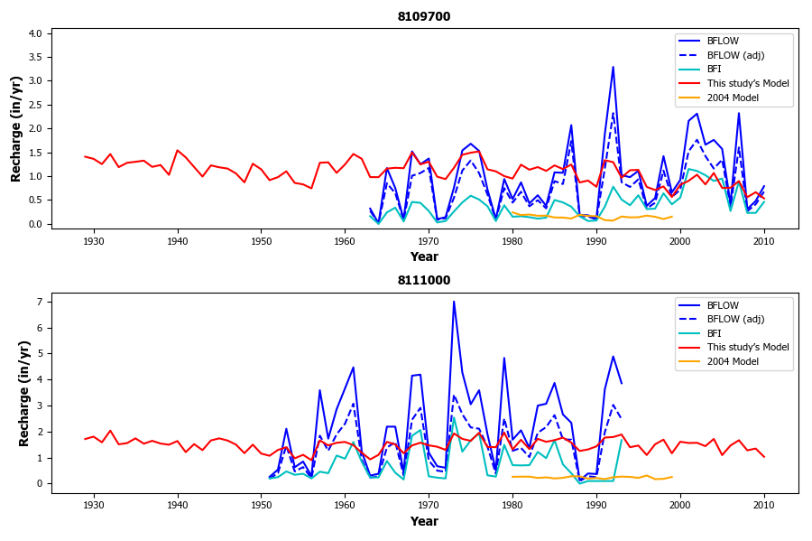
Quantifying SW-GW Interaction: Contribution of Groundwater to Baseflow

Slide 7
ASR Update
Methodology Complete
INTERA internal testing complete – working on validating our solutions with one being developed by UT-Austin
Discovered that recovery rate is very sensitive to nearby pumping
Ready to begin applications in POSGCD using revised GAM

Slide 8
University of Texas Project
Identification of Data Needs
  Aquifer hydraulic properties
  Groundwater geochemistry
Identification of Calculations and Modeling Approaches to Assess Feasibility of Water Injection, Storage and Recovery
  Approaches for calculations (injection rates, travel distances)
  Approaches for modeling (analytical and numerical models)
  Present two case study applications
Development of Tracer Test Guidelines to Demonstrate Injected Water Recovery
  Tracer test guidelines for applicants to follow to demonstrate injected water recovery using pilot or full scale ASR wells
  Documentation of one case study

Slide 9
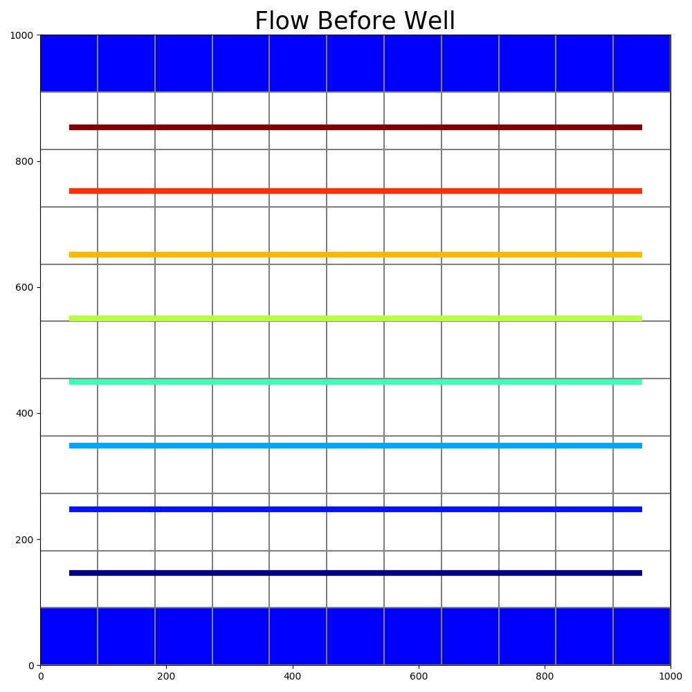
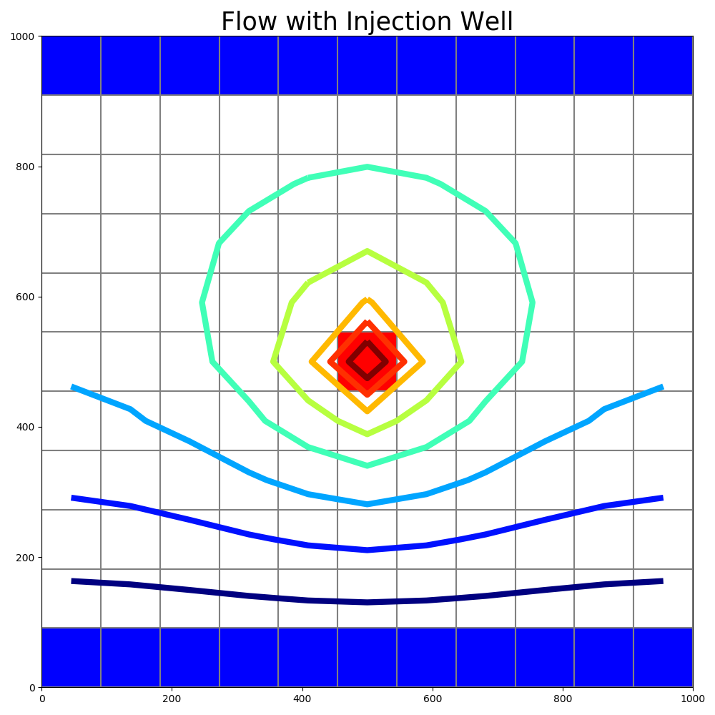
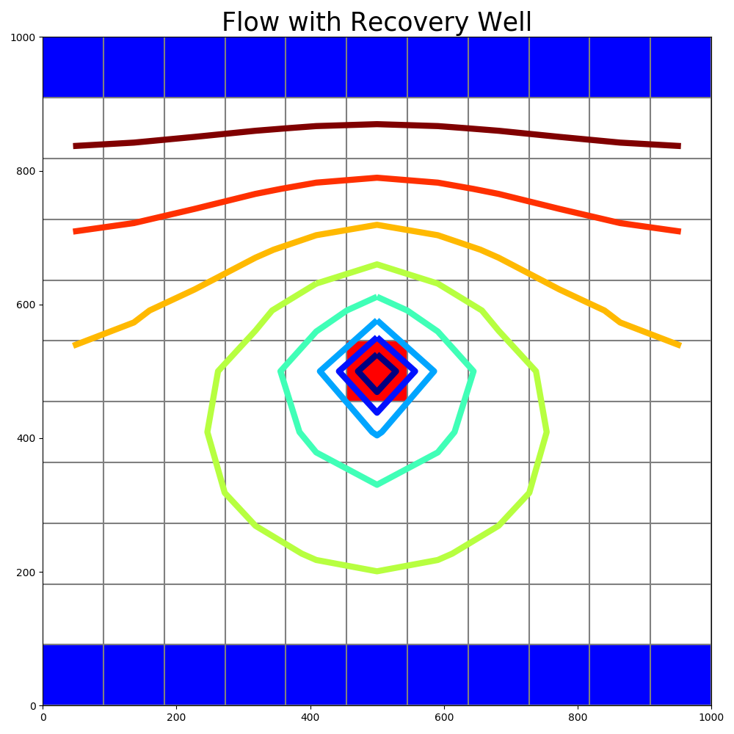
Methodology: Calculate Groundwater Water Levels using Groundwater Model
Contours of Water Levels before ASR Well begins operations
Contours of Water Levels During ASR Well Injection of Water
Contours of Water Levels During Extraction of Injected Water
High Water Level
Low Water Level

Slide 10
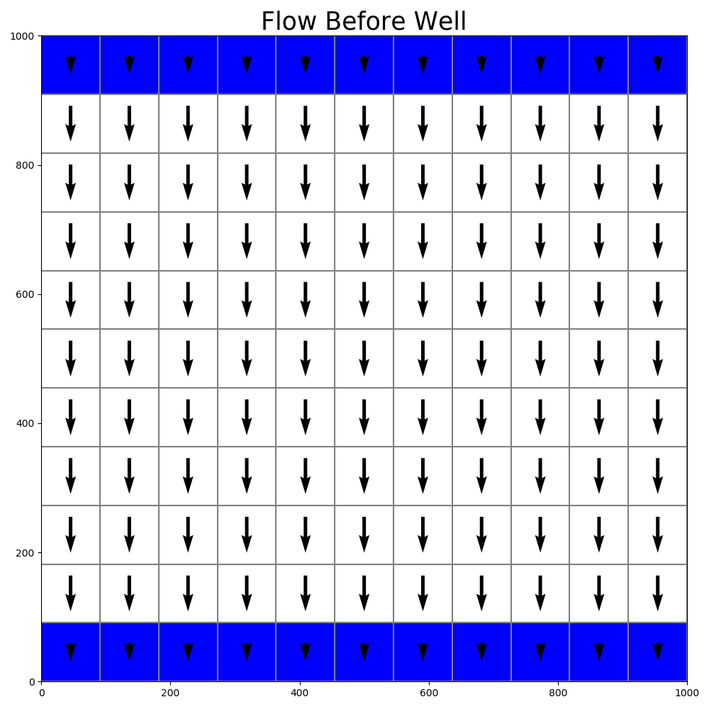
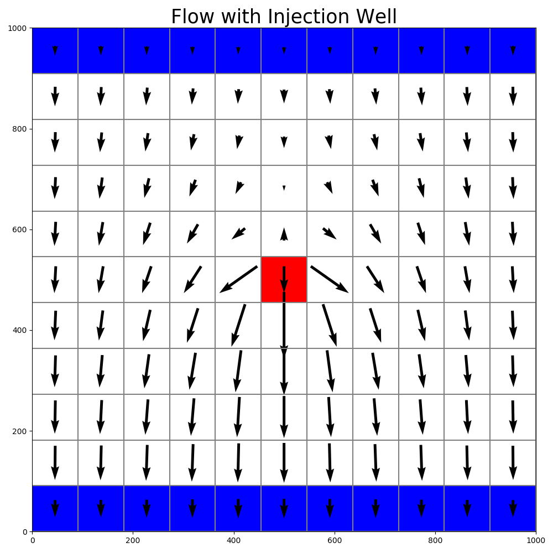
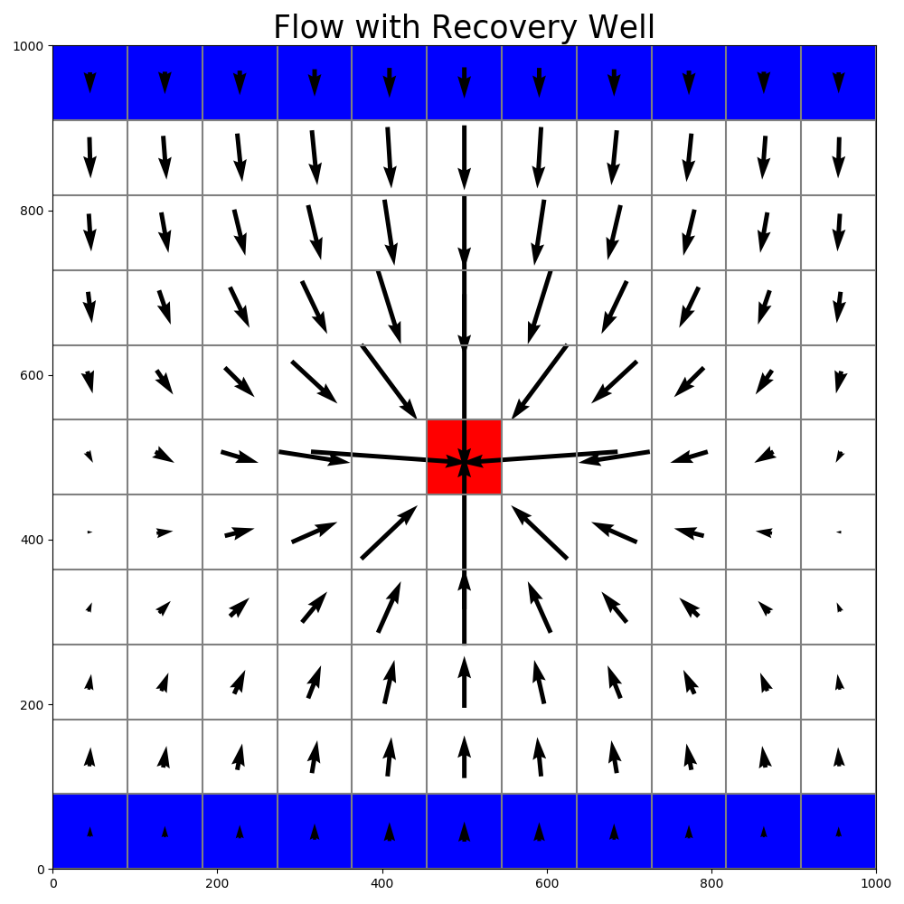

Methodology: Calculate Groundwater Flow Vectors using Groundwater Model
Groundwater Flow Vectors During ASR Well Injection of Water
Groundwater Flow Vectors During Extraction of Injected Water
Groundwater Flow Vectors before ASR Well begins operations
Direction of Flow

Slide 11
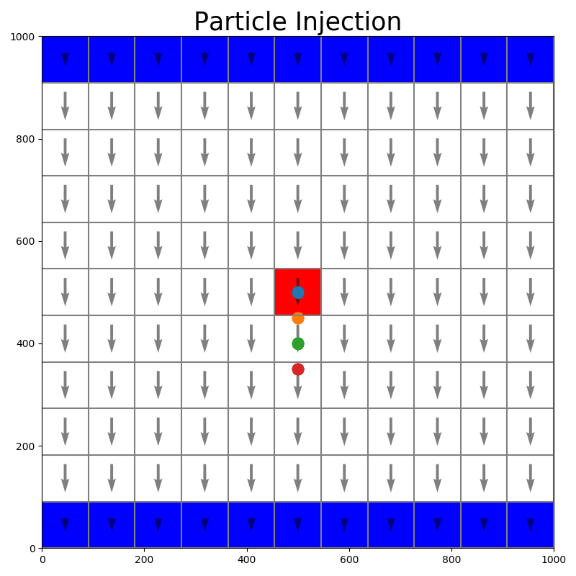
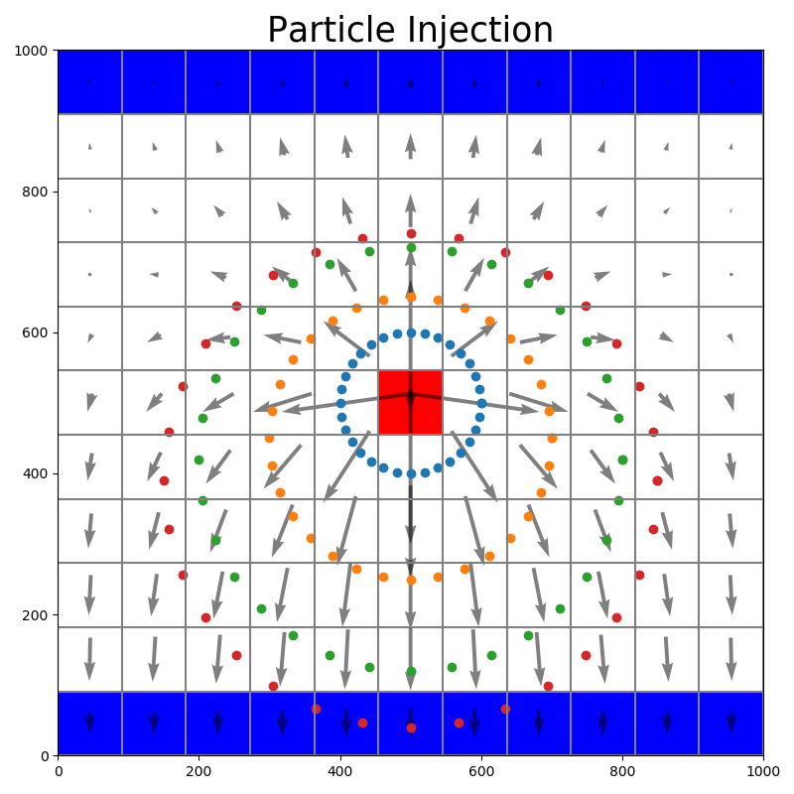



Methodology: Track Particles in Groundwater Flow Field using Groundwater Model
Particle Tracking During ASR Well Injection of Water
Particle Tracking During Extraction of Injected Water
Particle Tracking Before ASR Well begins operations

Slide 12
Predicted Recovery Efficiency for Single ASR Well (1 year cycle)
ASR well
ASR well
ASR well
ASR well
No Nearby Well
1100 ft
2200 ft
4400 ft
Existing Nearby Well
Existing Nearby Well
Existing Nearby Well
Inject water at 100 gpm for 11 months
Extract water at 1100 gpm for 1 month
Calculate Recovery Efficiency after 24 months

Slide 13
Predicted Recovery Efficiency for Single ASR Well (10 year cycle)
ASR well
ASR well
ASR well
ASR well
No Nearby Well
1900 ft
3800 ft
7600 ft
Existing Nearby Well
Existing Nearby Well
Existing Nearby Well
Inject water at 100 gpm for 9.5 years
Extract water at 1900 gpm for 0.5 years
Calculate Recovery Efficiency after 20 years

Slide 14
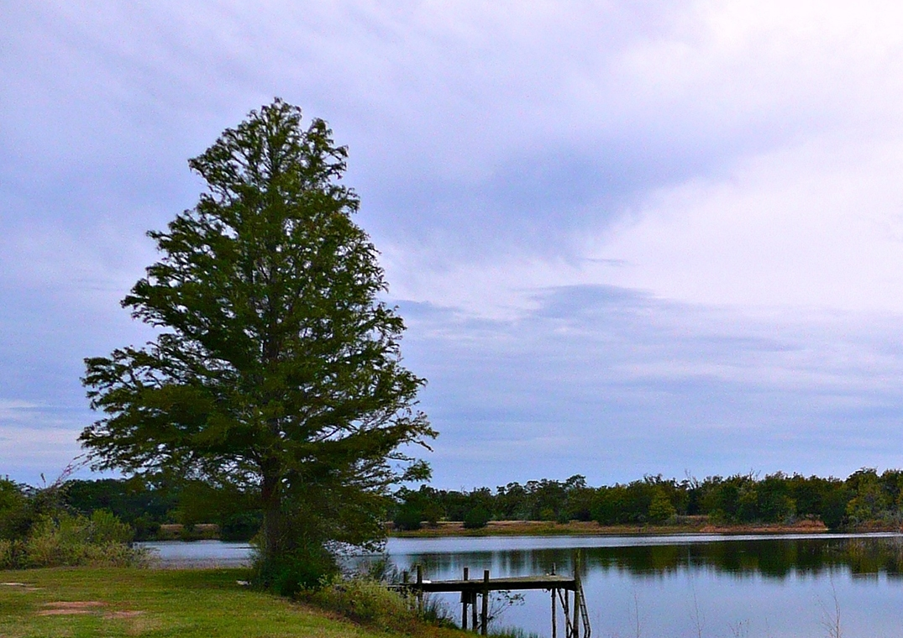
QUESTIONS ?
Questions ?

