Slide 1
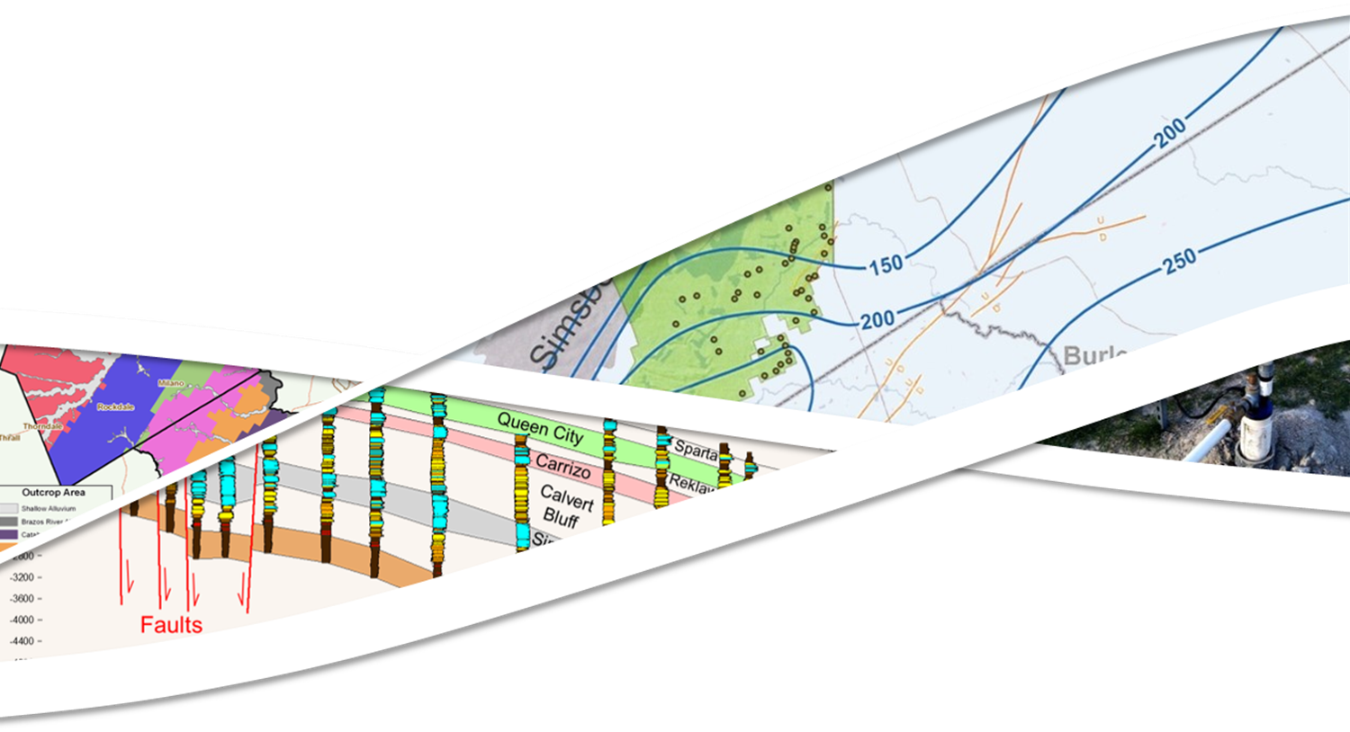


POSGCD Desired Future Conditions Committee
Presented By:
Steve Young
March 8, 2022

Slide 2
Outline
Simulation of Simsboro and Carrizo Aquifer WLs from DFC GAM Run for GMA 12 (12 minutes)
DFC Compliance Based on Revised Analysis Methods
(25 minutes)
Boundaries for “Management Zones” Associated with DFCs
(20 minutes)
Maximum Production Volumes Based on Permitted Acreage
(30 minutes)
Compatibility of DFCs and PDLs (10 minutes)
Update on GMA 12 Joint Planning (2 minutes)
Questions (until 5:00 pm)

Slide 3
Review of S-19 DFC GAM Run for GMA 12

Slide 4
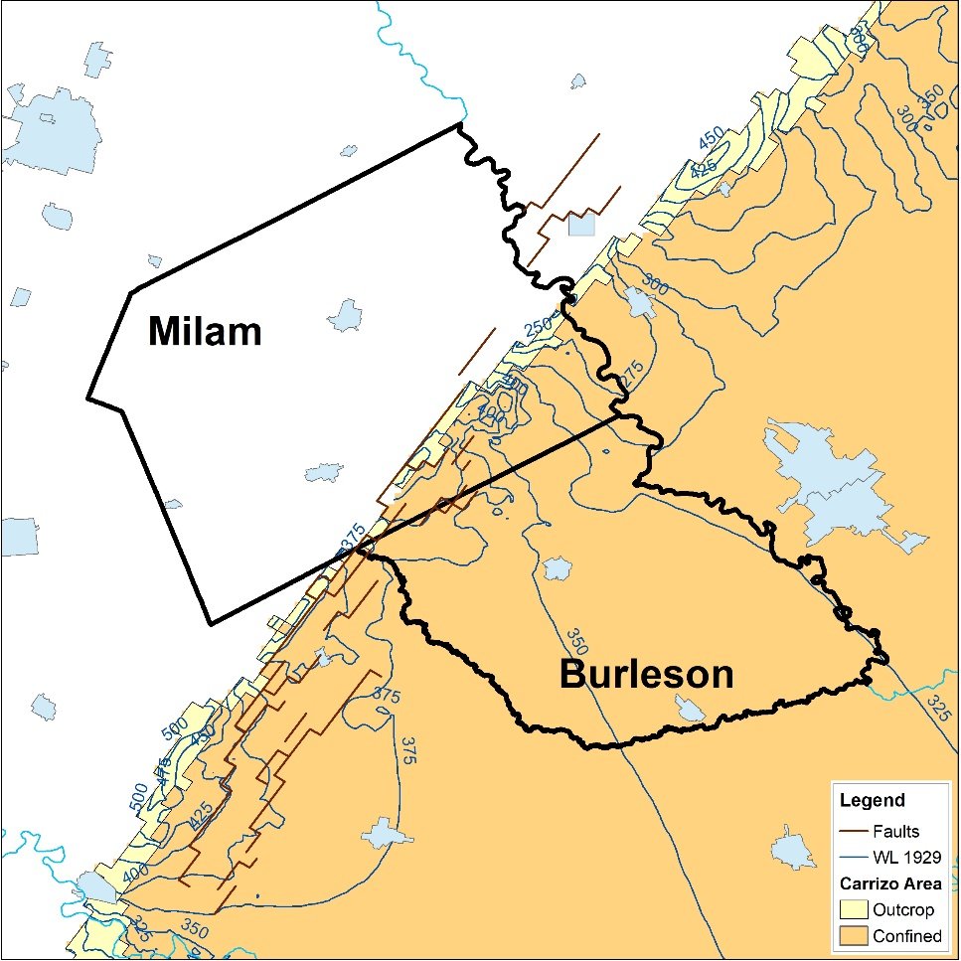
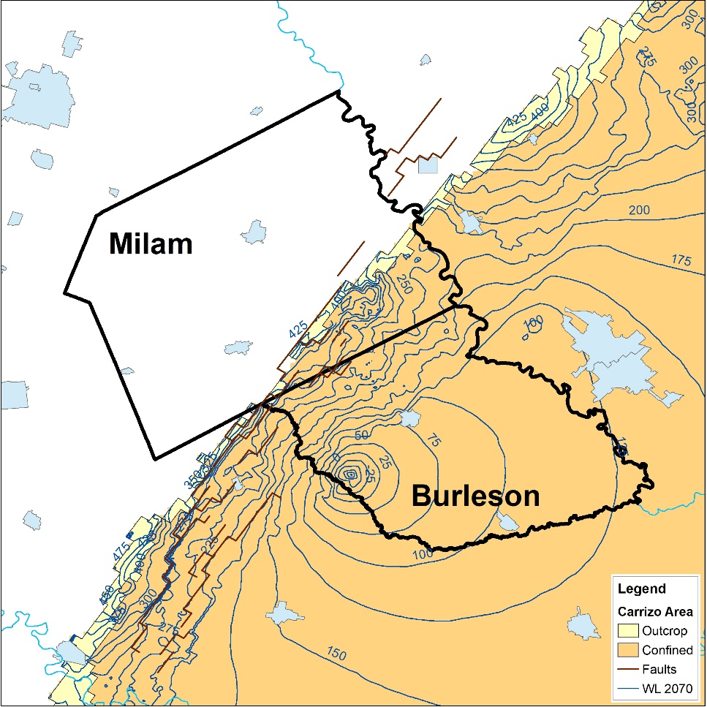
Carrizo Simulated Water Level
1929
2070

Slide 5
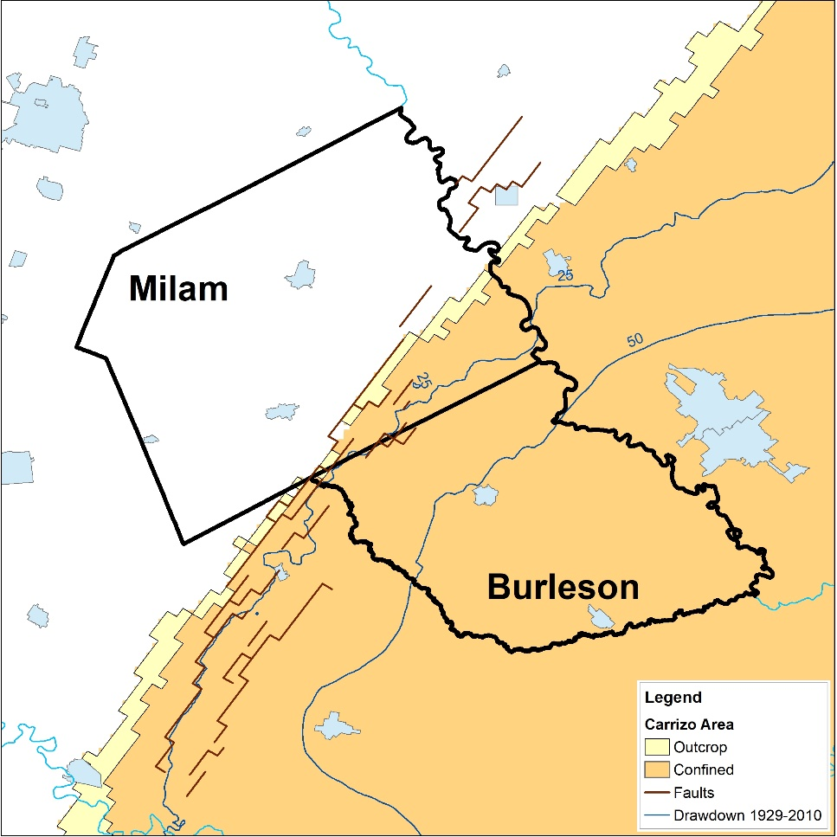
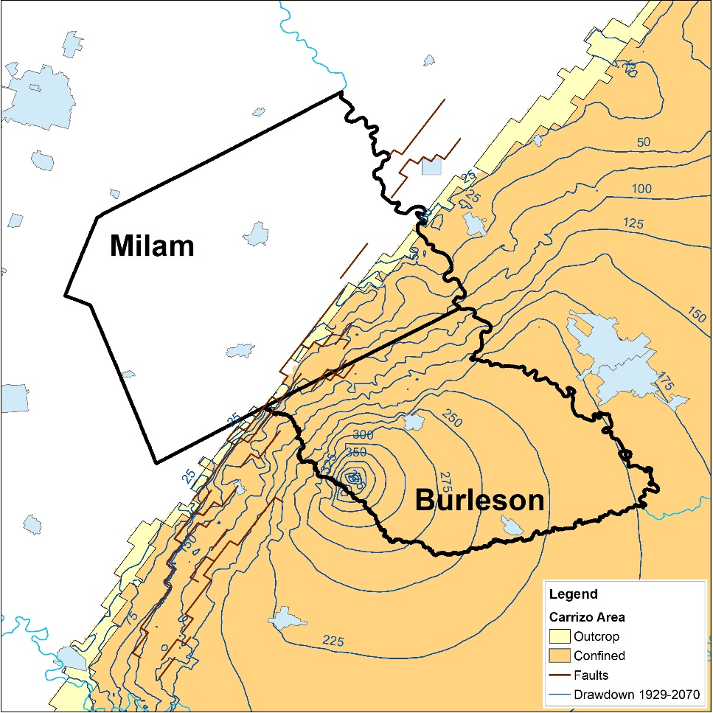
Carrizo Simulated Drawdowns
1929 -2010
2010-2070

Slide 6
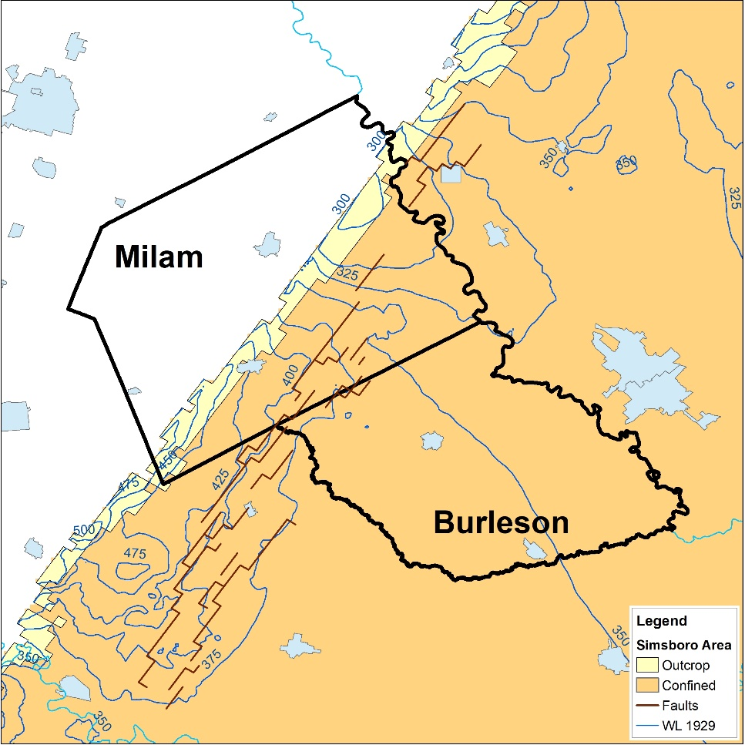
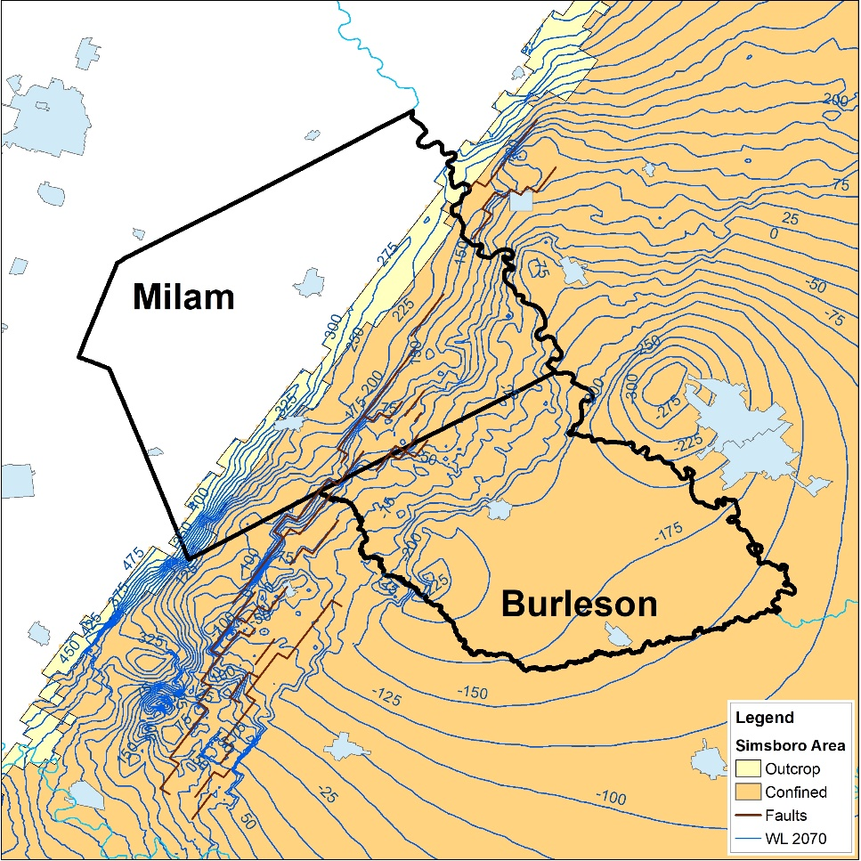
Simsboro Simulated Water Level
1929
2070

Slide 7
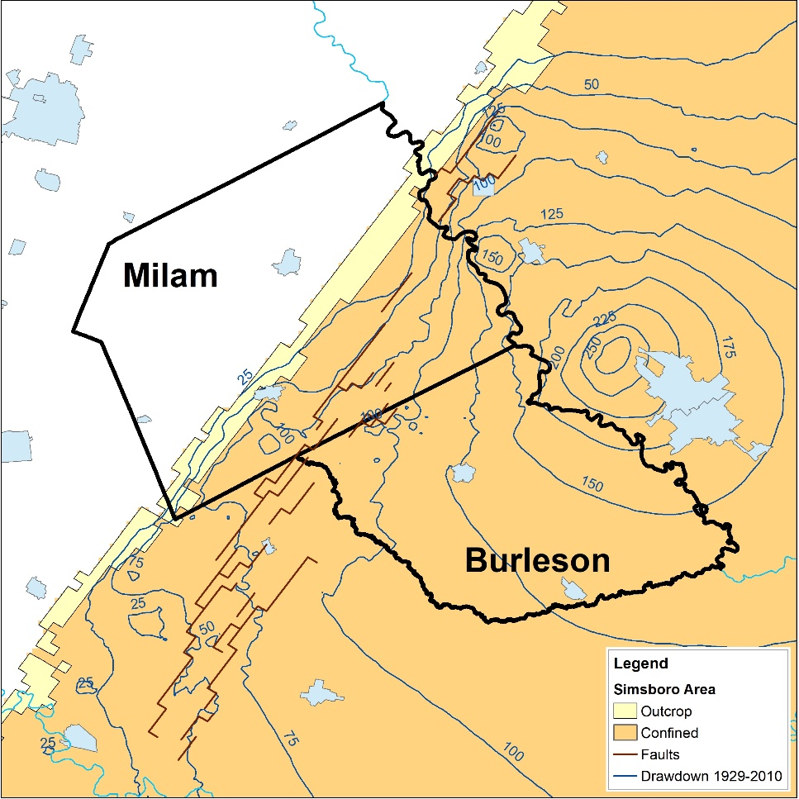
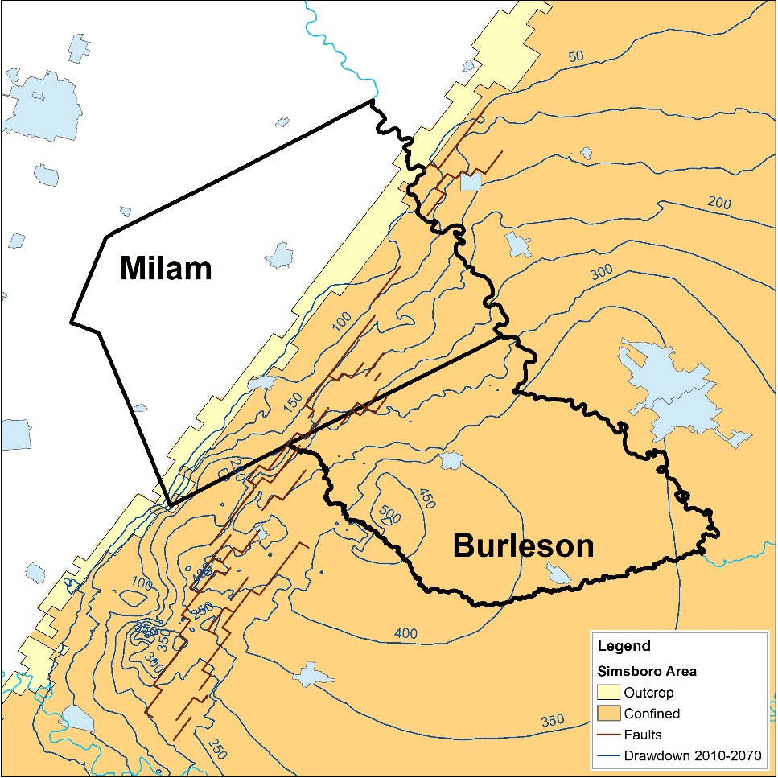
Simsboro Simulated Drawdowns
1929 -2010
2010-2070

Slide 8
Summary
Observations
  Significant trends/patterns exists in the water level contours and drawdown contours
  2010-2070 drawdowns vary between ~ 50 feet to 300-450 feet
  Outside of the well fields, drawdowns are generally greater in deeper than shallower portions of the aquifer
Implications to Interpolation of Measured Water Levels for DFC compliance
  Shallow water levels/drawdowns cannot be reliably extrapolated to deep zones without secondary information
  Data outside of a POSGCD is needed in order to properly interpret data inside POSGCD
  Location of data as similar importance than the amount of data

Slide 9
DFC Compliance Based on Revised Analysis Methods

Slide 10
Major Updates to Guidance Document
Addition of Transducer Wells
Update Monitoring Well Information Including Aquifer Assignments
Averaging Period Changed from November 1 to April to January 1 to April 30
Option to Use Common Wells or All Available Wells for Each Year
Expanded Data Analysis Methods to Include Two Geostatistical Methods
  Kriged Water Levels
  Kriged Residual

Slide 11
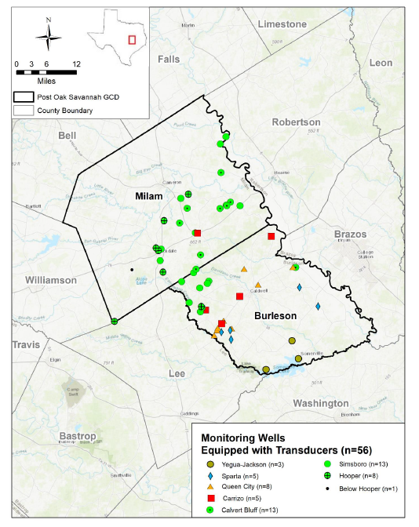
Monitoring Wells: Addition of Transducer Wells
  Total= 323 (109 in 2018)
  w/Transducer =55 (20 in 2018)

Slide 12
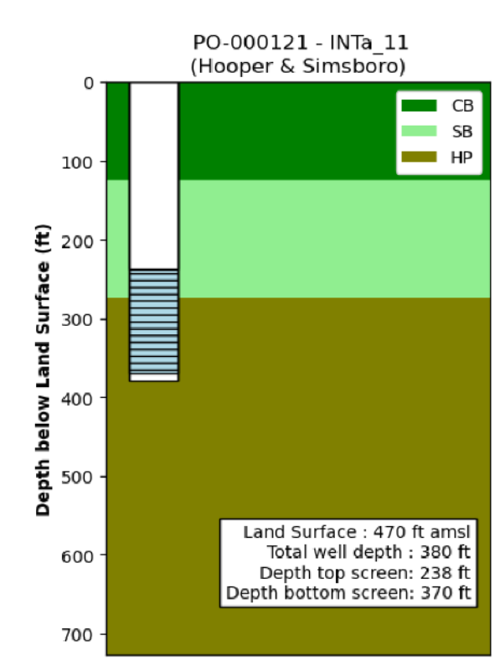
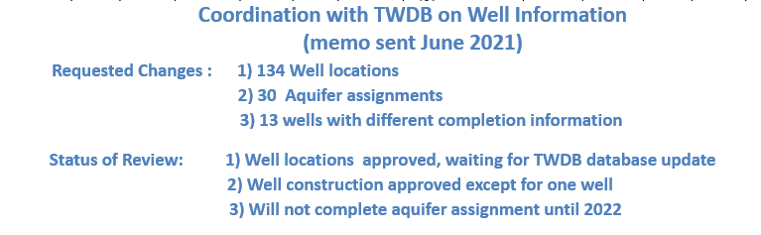
Monitoring Wells: Aquifer Assignment
70% of the well screen needs to be in an aquifer
Using information from GAM and geophysical logs

Slide 13
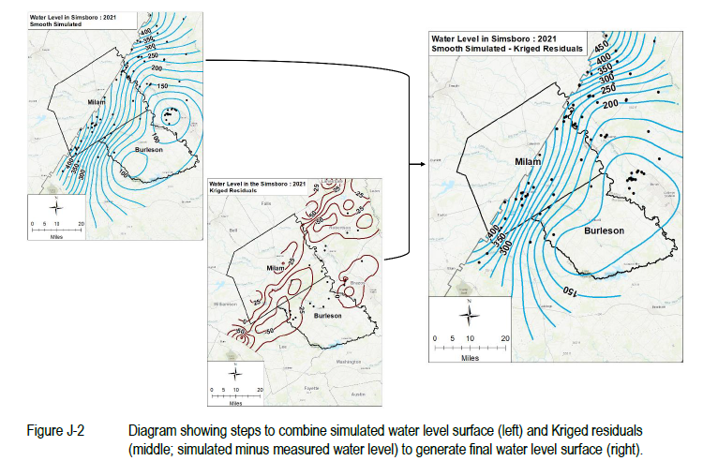
Data Analysis Method for Calculating Average Drawdowns

Slide 14
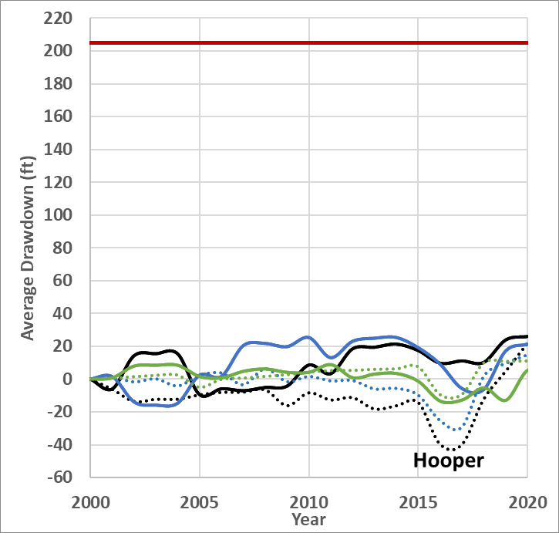
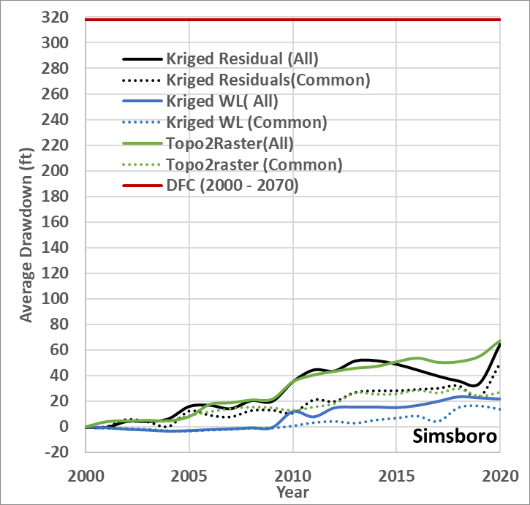
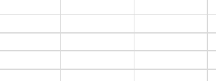
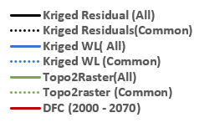
Revised Averaged Drawdowns (draft): Hooper & Simsboro
2021 Compliance Report
2020 - 10.7 ft
2021 Compliance Report
2020 - 32 ft

Slide 15
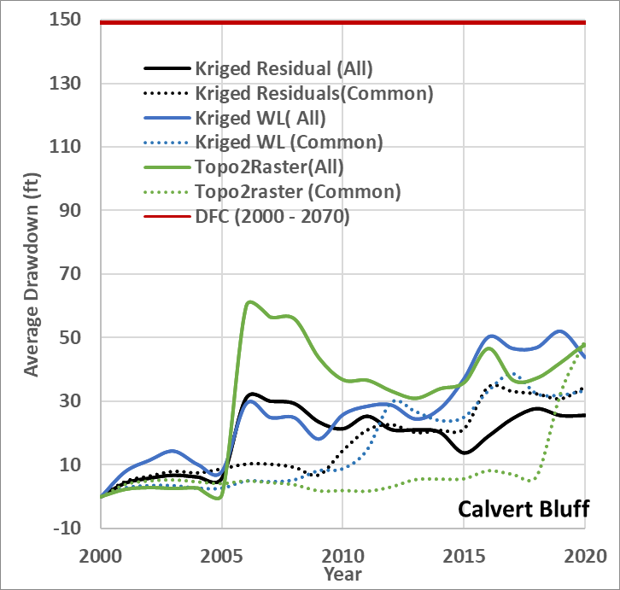
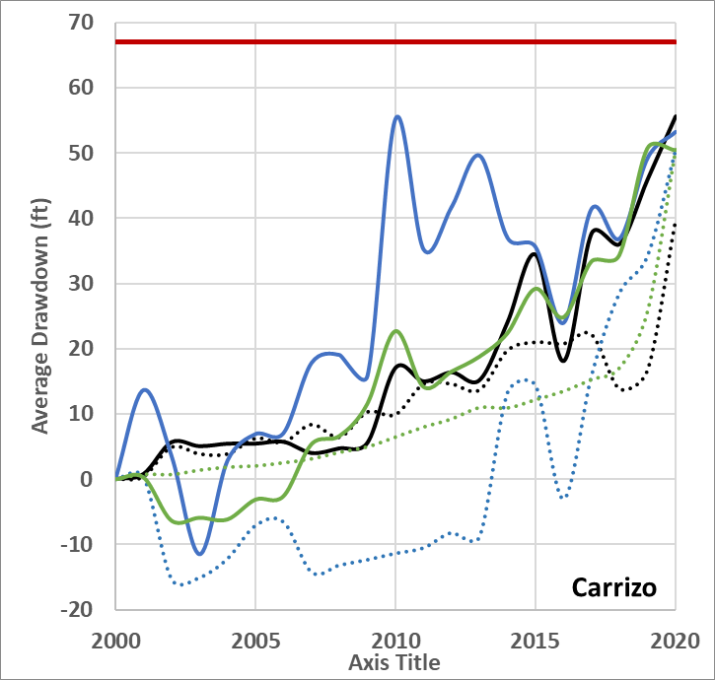

Revised Average Drawdowns (draft): Calvert Bluff & Carrizo
2021 Compliance Report
2020 - -56.5 ft
2021 Compliance Report
2020 - 48.2 ft

Slide 16
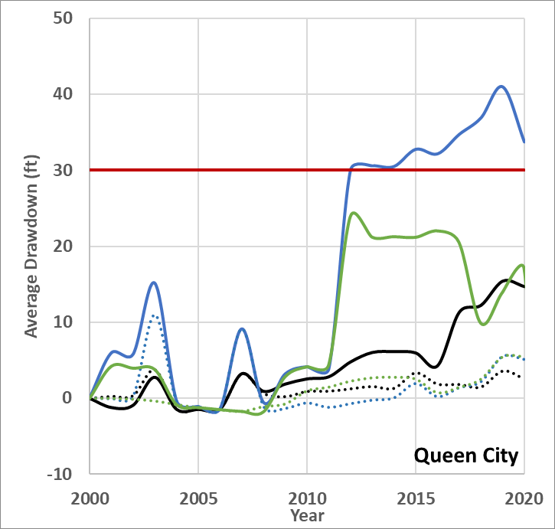
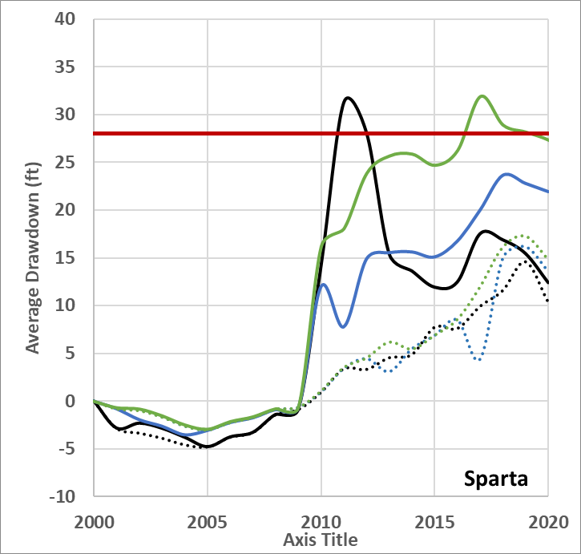
Revised Average Drawdowns (draft): Queen City & Sparta
2021 Compliance Report
2020 - 4.2 ft
2021 Compliance Report
2020 - 14.3 ft

Slide 17
Summary of Calculated Average Drawdowns for 2000-2020
Use of common wells consistently produces less drawdown
Variability among annual drawdowns much less for Carrizo-Wilcox aquifers than for Queen City and Sparta aquifers
The differences among three methods can vary significantly among successive years
Results are sensitive to outliers (WLs need to be carefully checked)
Results are sensitive to non-POSGCD WL data
Kriged Residual Method produces most consistent set of water level contours

Slide 18
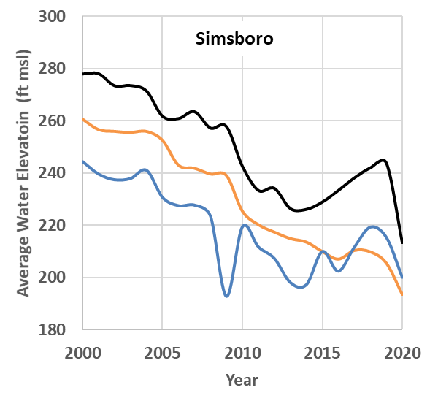
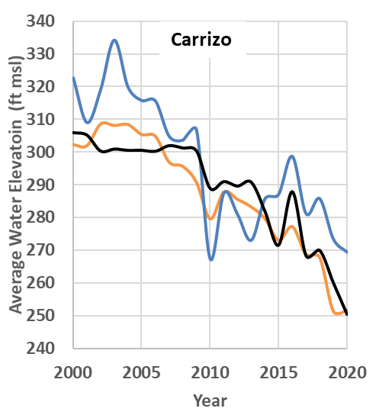

Calculated Average Water Levels (con’t)

Slide 19
Summary
Analysis Method
  Primary: Kriging with Residuals
  Secondary: Kriging with Water Levels, Topo2raster
Aquifer Assignment
  Geological Analysis & Water Levels
  GAM Surfaces
Well Selection
  All available wells for each year
  Use 70% threshold for application
Water Levels
  Examine hydrographs trends against pumping trends
  Check documentation of well condition during pumping

Slide 20
On-going Work
Additional TWDB & Adjacent GCD Coordination
  Well Data
  Aquifer Surfaces
Prioritize Water Level Measurements
  “70%” wells
  “Isolated” wells
  Investigate Option of Using Index Wells
Technical Analysis
  Assessment of confidence limits for each method
  Improvements to POSGCD operation model
  Consideration of water level considerations

Slide 21
Boundaries for “Management Zones” Associated with DFCs

Slide 22
Review of Management Zones
RULE 16.1. MANAGEMENT ZONES. Groundwater availability will be conserved, preserved and protected by well spacing, permit requirements, and/or limiting water drawdown levels within the Management Zones listed in Section 5 of the Management Plan. The District’s rules and regulations will be adopted and enforced in compliance with Chapter 36, Texas Water Code, and the Board will take action as needed to accomplish the Desired Future Conditions.
MP Section 5. Management Zones. The District is divided into groundwater management zones for the purpose of evaluating and managing groundwater resources recognizing the different characteristics
and anticipated future development of the aquifers in the District.
The District will establish and enforce Rules for the spacing of wells, the maximum allowable production of groundwater per acre of land located over an aquifer, require permits for production, regulate drawdown and provide for a reduction in the maximum allowable production and permitted production of groundwater per acre of land based on the different surface and subsurface characteristics and different evaluation and monitoring within the Management Zones.
TWC 36.108 (d-1). After considering and documenting the factors described by Subsection (d) and other relevant scientific and hydrogeological data, the districts may establish different desired future conditions for: (1) each aquifer, subdivision of an aquifer, or geologic strata located in whole or in part within the boundaries of the management area; or (2) each geographic area overlying an aquifer in whole or in part or subdivision of an aquifer within the boundaries of the management area

Slide 23
DFC Areas and Management Zones
Current Approach
  DFC area boundaries match the boundary of the entire aquifer in POSGCD which also matches the boundaries of the Management Zones
  Difficult to monitor and difficult to protect areas near outcrops where majority of exempt well exist
Alternative Approach
  Partition Management Zones into multiple DFC Areas based location of existing wells
  Improve protection of wells near outcrop and shallow regions of the aquifer
  Improve opportunity to successfully monitor and enforce DFC compliance

Slide 24
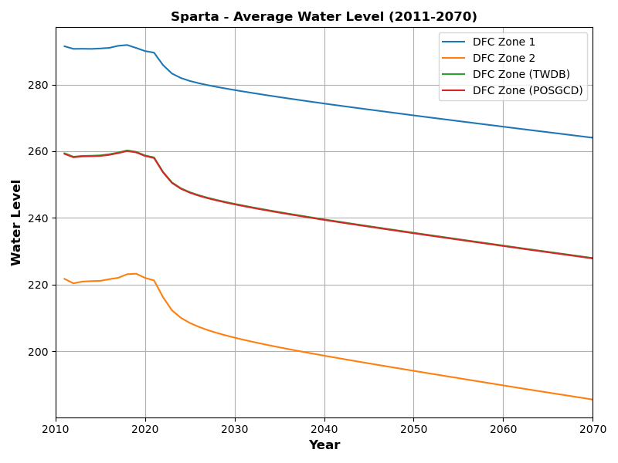
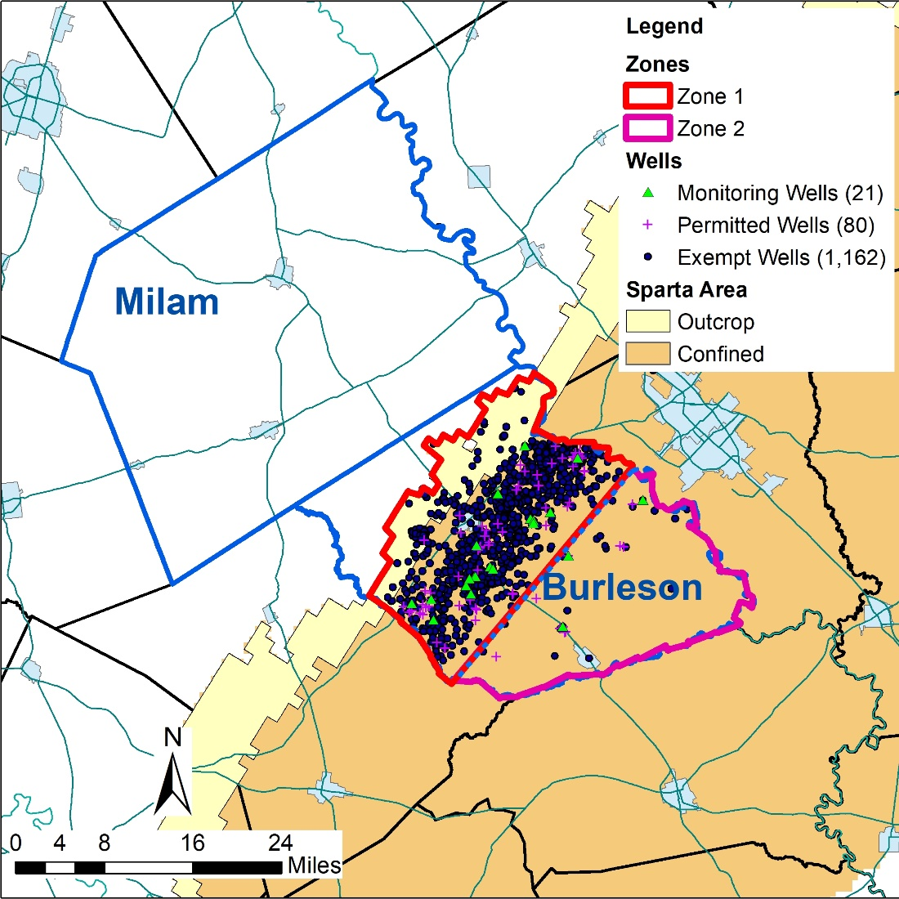
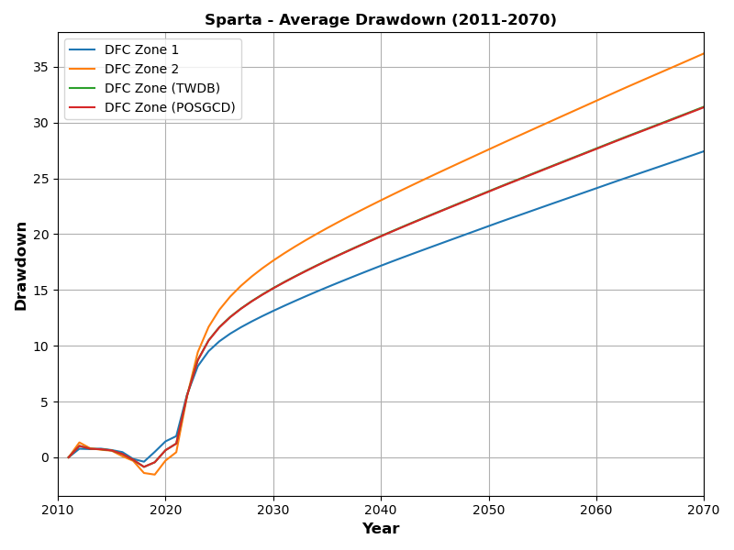
DFC Zones: Sparta

Slide 25
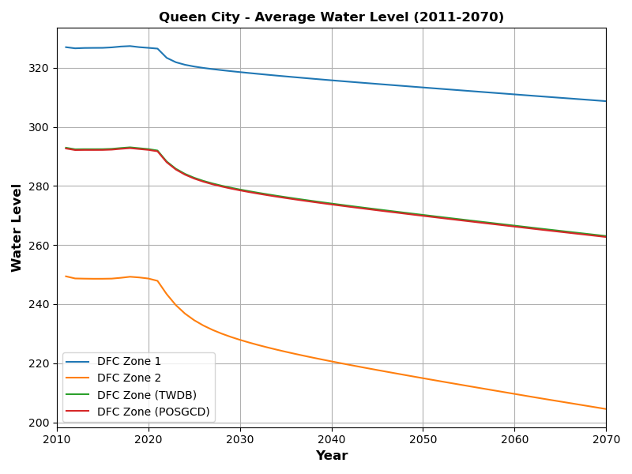
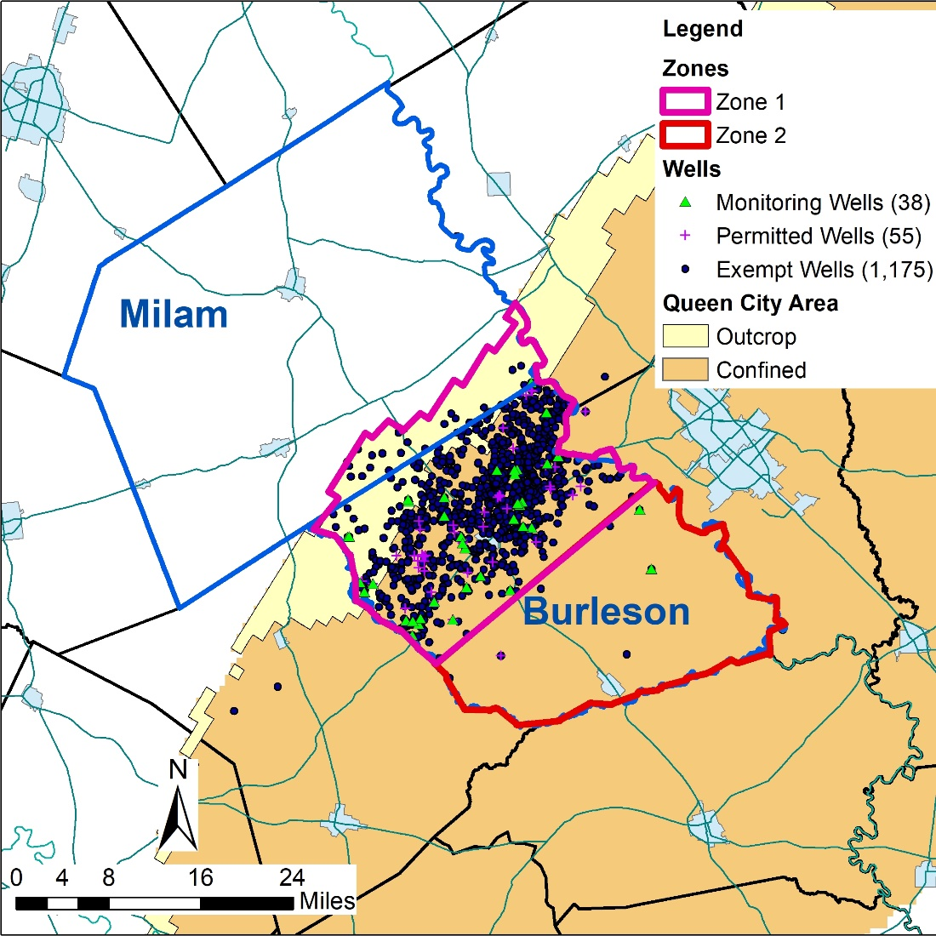
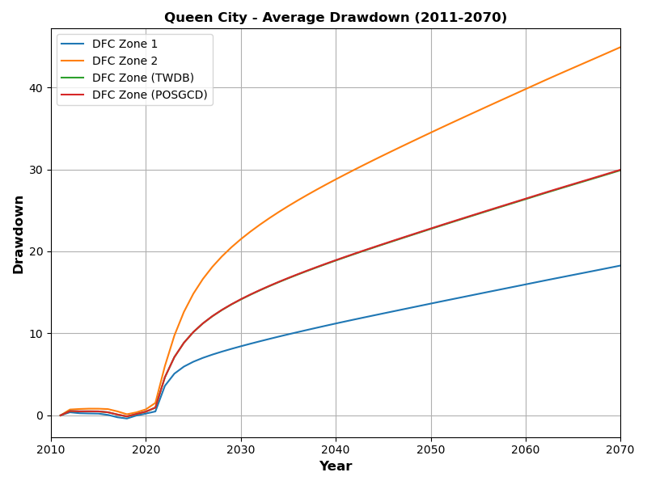
DFC Zones: Queen City

Slide 26
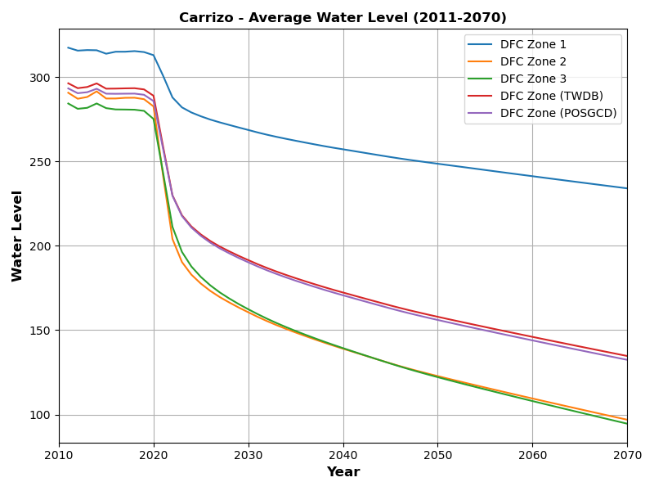
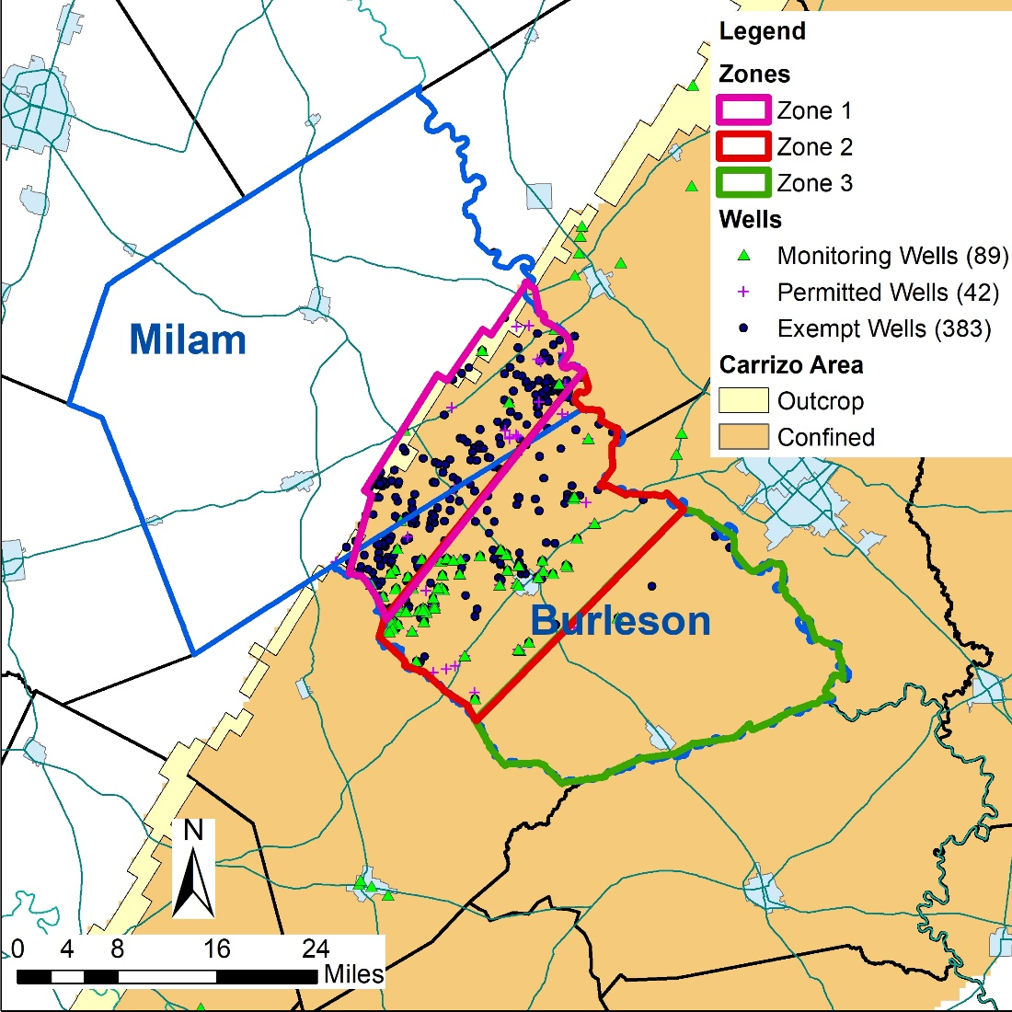
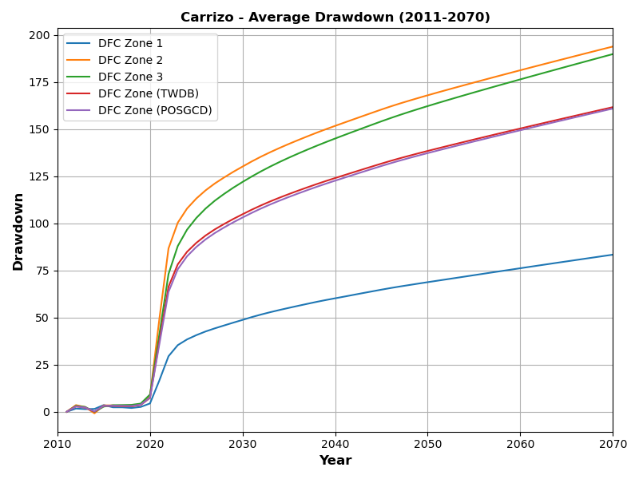
DFC Zones: Carrizo

Slide 27
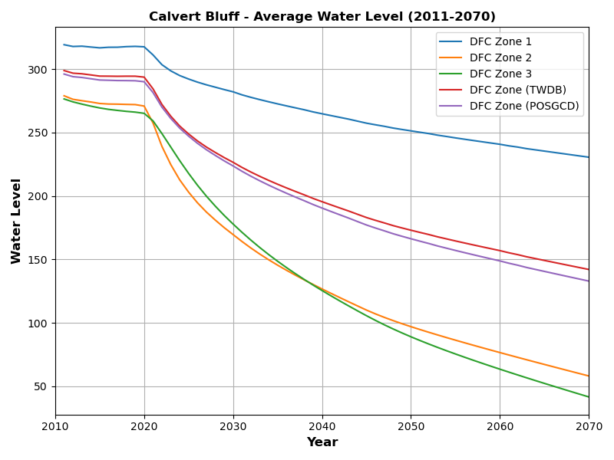
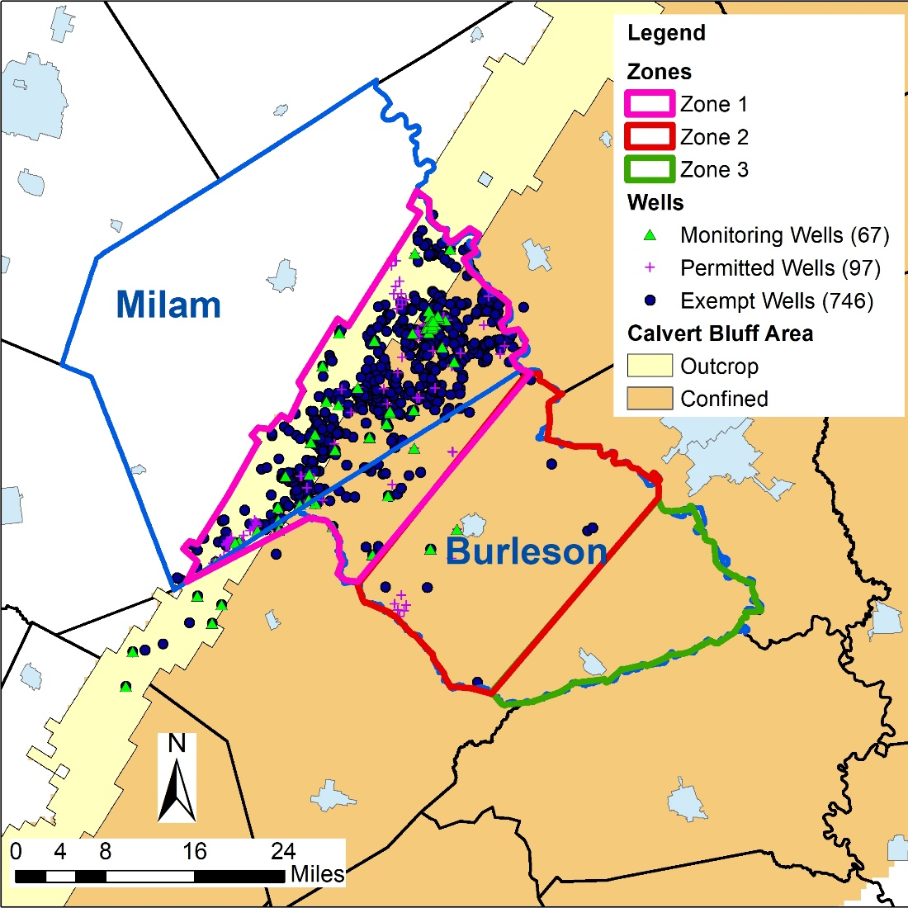
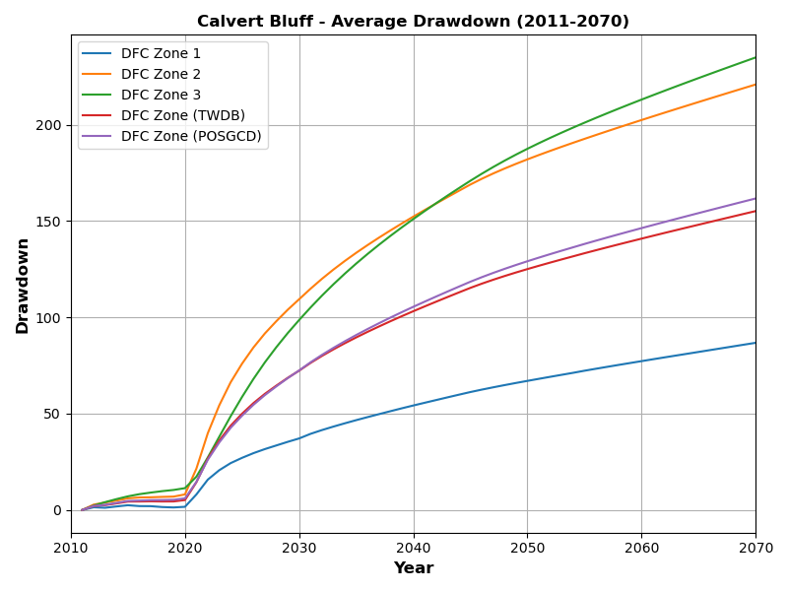
DFC Zones: Calvert Bluff

Slide 28
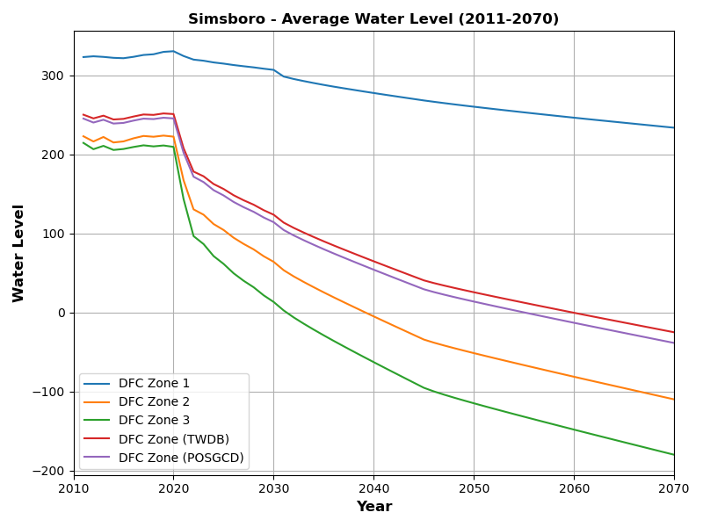
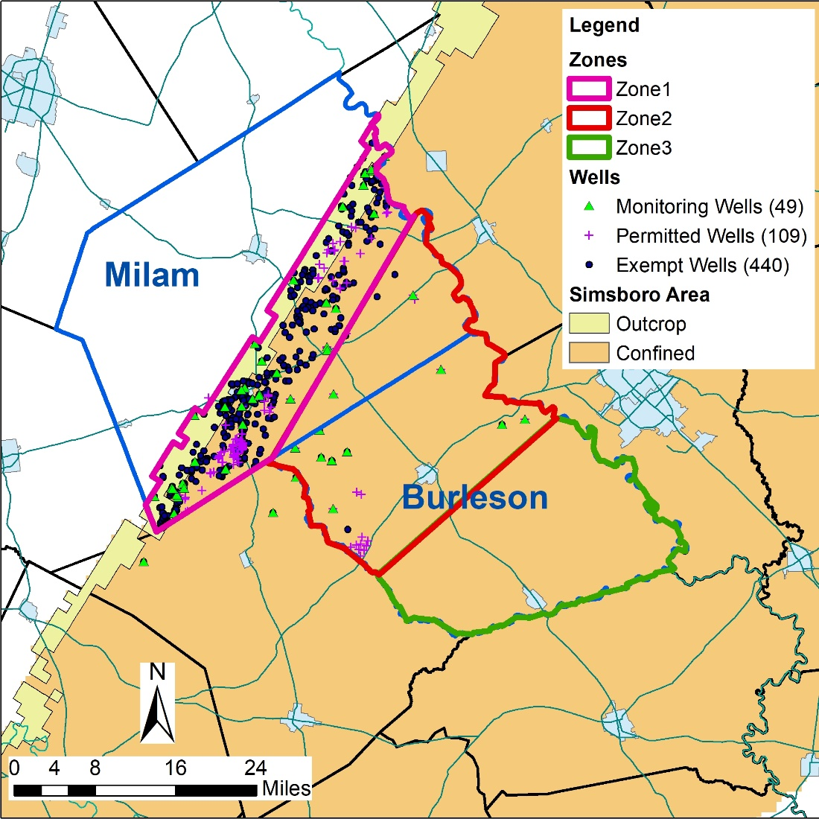
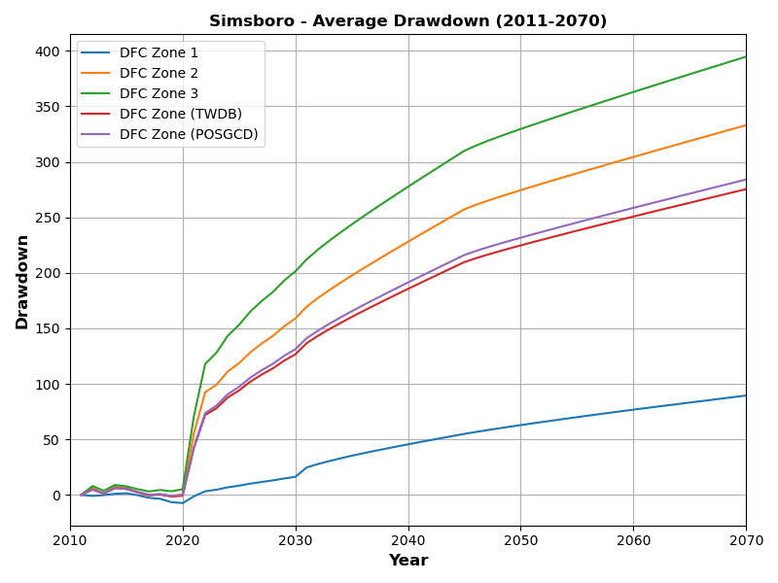
DFC Zones: Simsboro

Slide 29
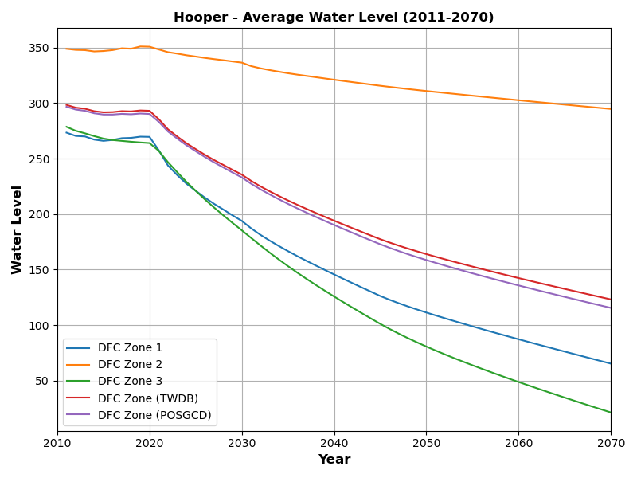
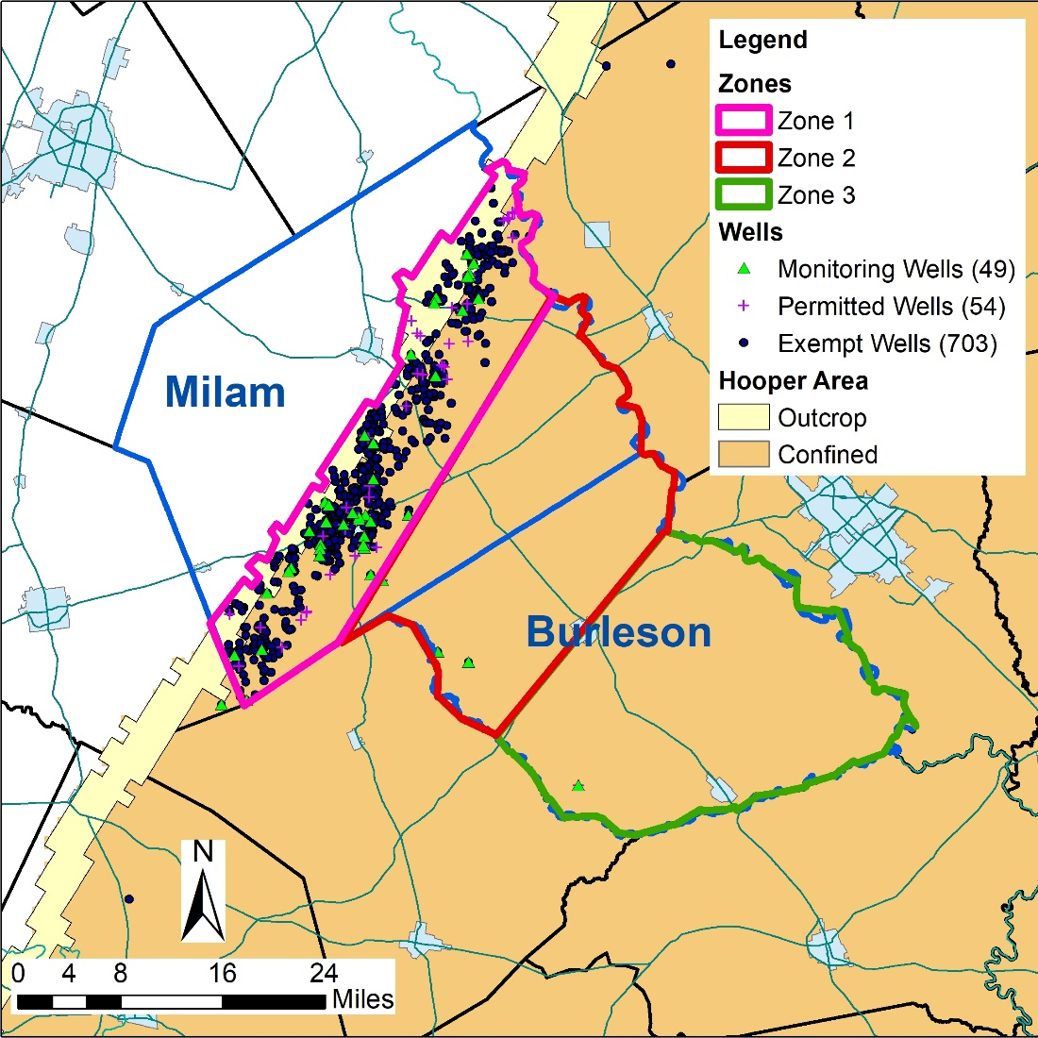
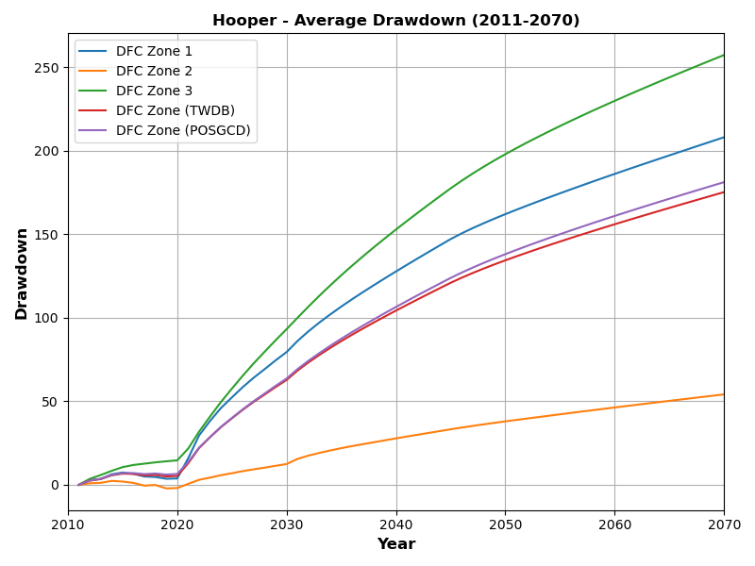
DFC Zones: Hooper

Slide 30
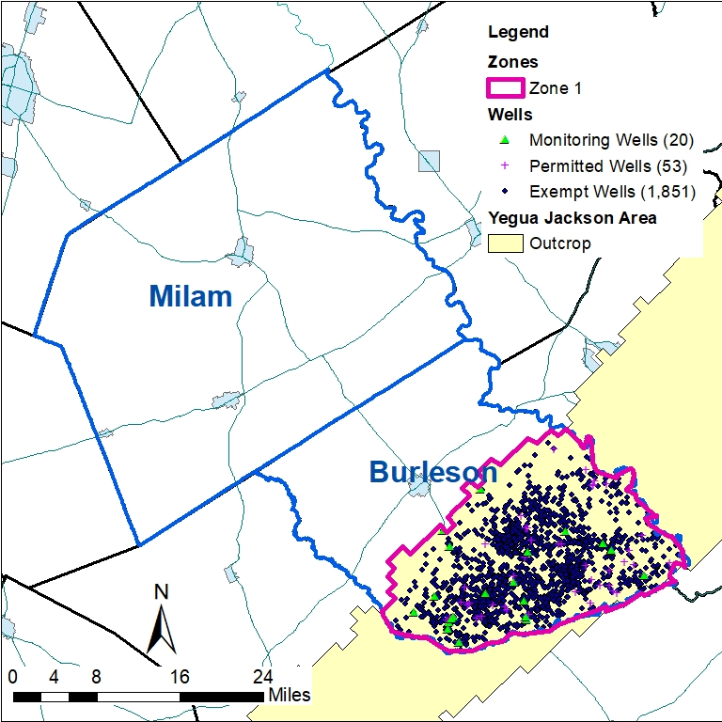
DFC Zones: Yegua Jackson

Slide 31
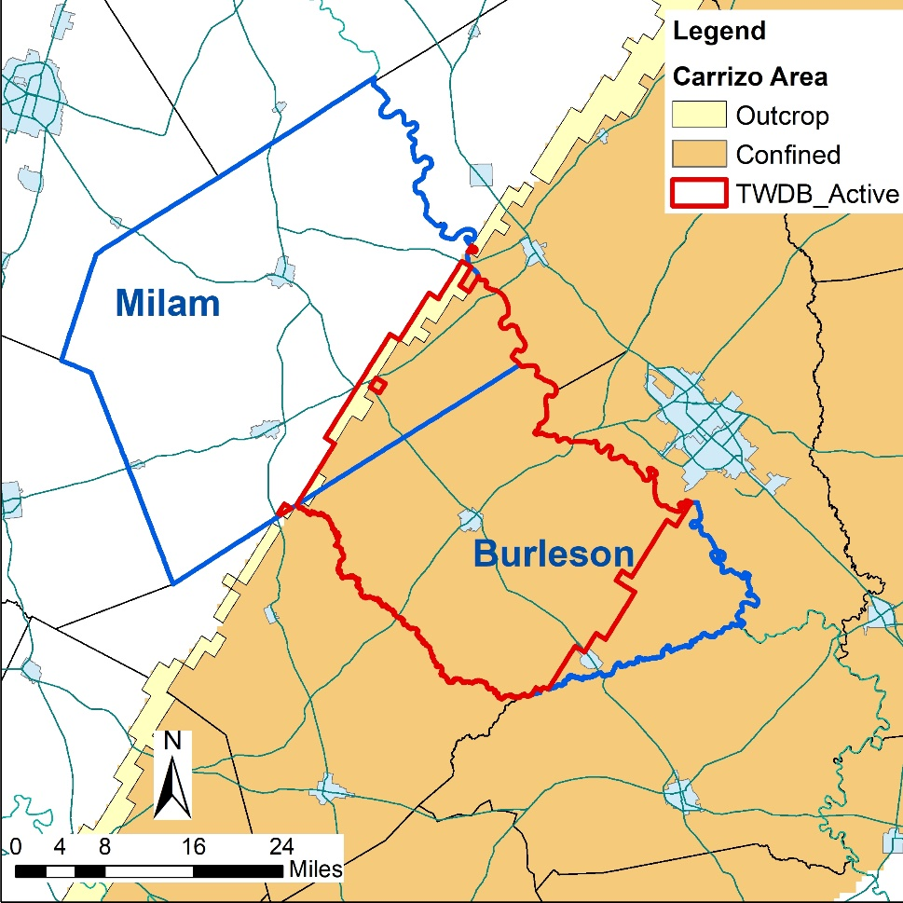
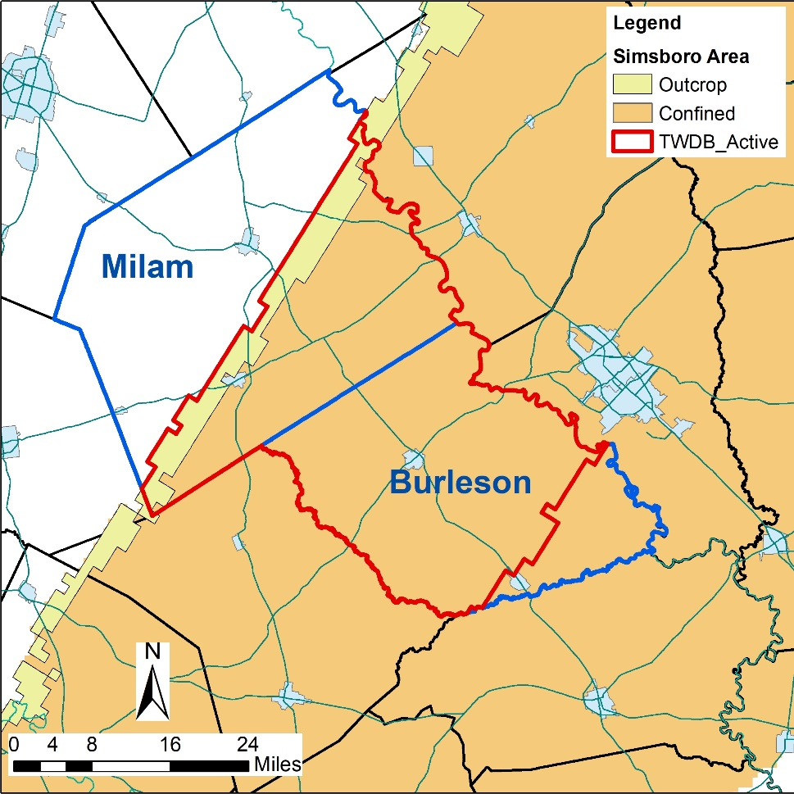
TWDB Designation of Active Zones
Active Zone is the portion of the aquifer with a Total Dissolved Solids Concentration < 3,000 mg/L

Slide 32
Summary
Suggested DFC Areas
  YJ aquifer – 1 area
  SP and QC aquifers – 2 areas
  CZ, CB, SB, and HP aquifers – 3 areas
Benefits over Existing Practice
  Improved reliability of DFC Compliance calculations
  Higher probability of enforcing DFC compliance

Slide 33
Maximum Production Volumes Based on Permitted Acreage

Slide 34
POSGCD Current Practice for Maximum Production
Maximum Production
  Correlative right based on contiguous acreage
  Current maximum production rate is 2 acre-ft/acre
Potential Strengths
  Simple to implement
  Little opportunity for challenging production calculations
Potential Weaknesses
  Ignores amount of groundwater underlying land
  Ignores aquifer production capacity underlying land

Slide 35
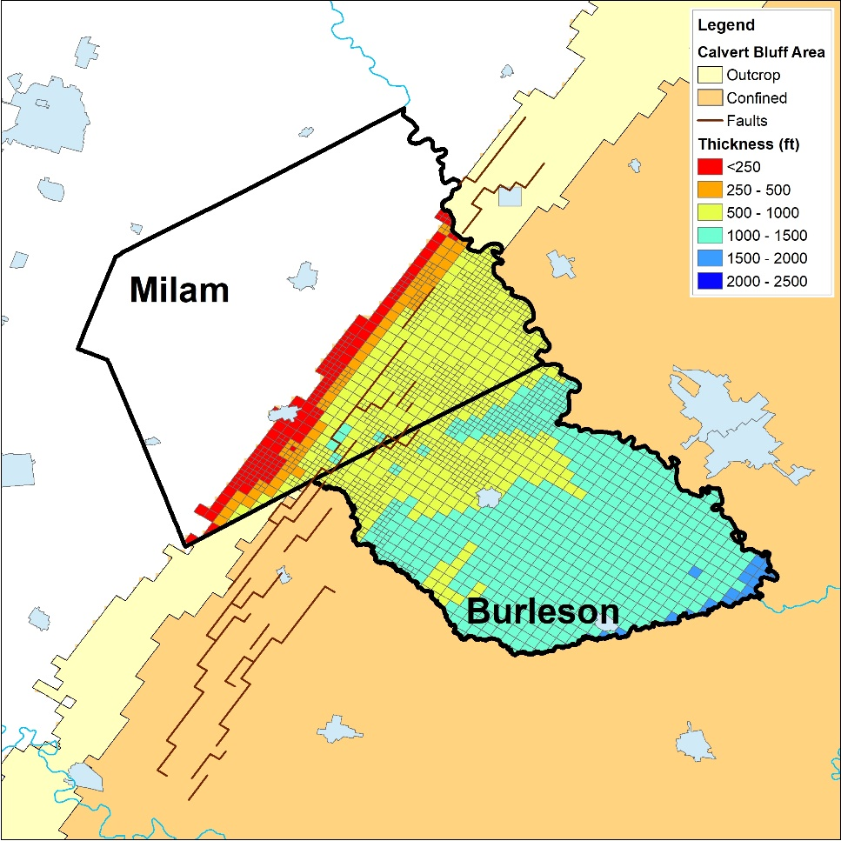
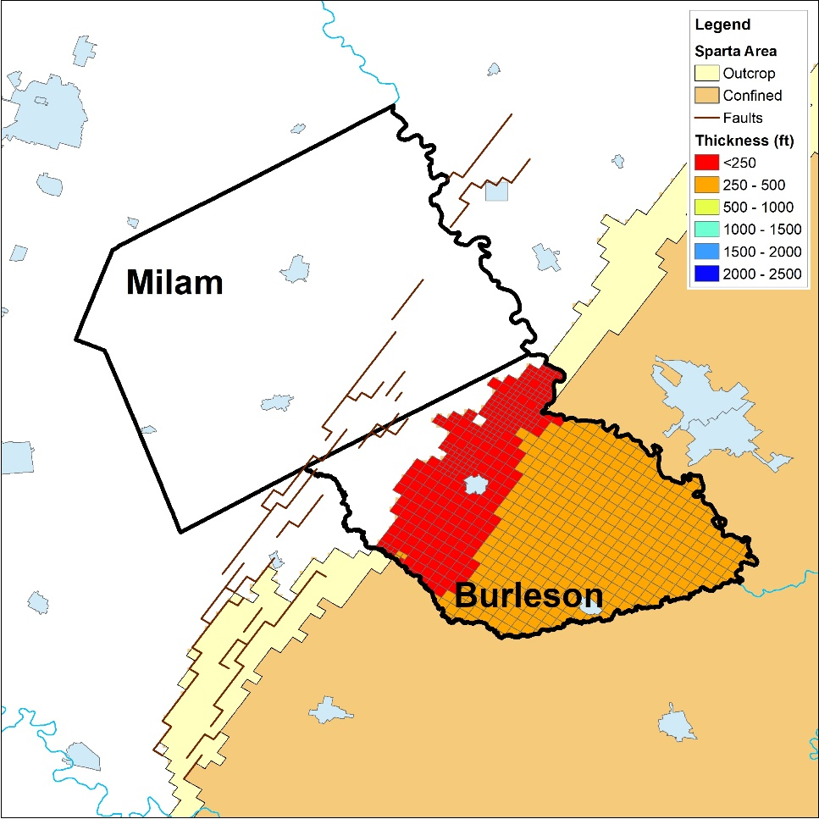
Calculation of Groundwater in Storage
Specific Yield (-)
Gravels | 0.15 to 0.35
Sands | 0.10 to 0.30
Silts | 0.03 to 0.20
Clays | 0 to 0.05
Storage = Sy * B_{s}
Sy = Specific yield (-)
B = saturated aquifer thickness (ft)

Slide 36
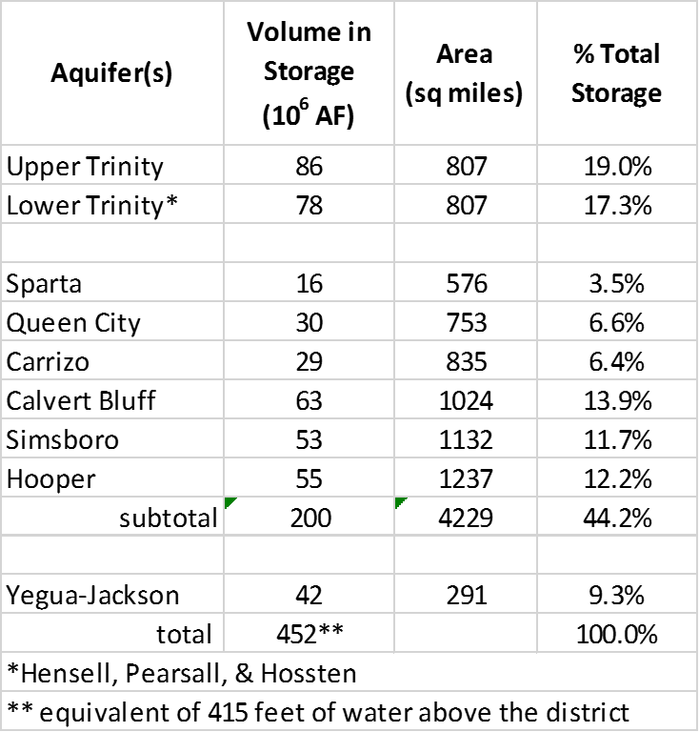
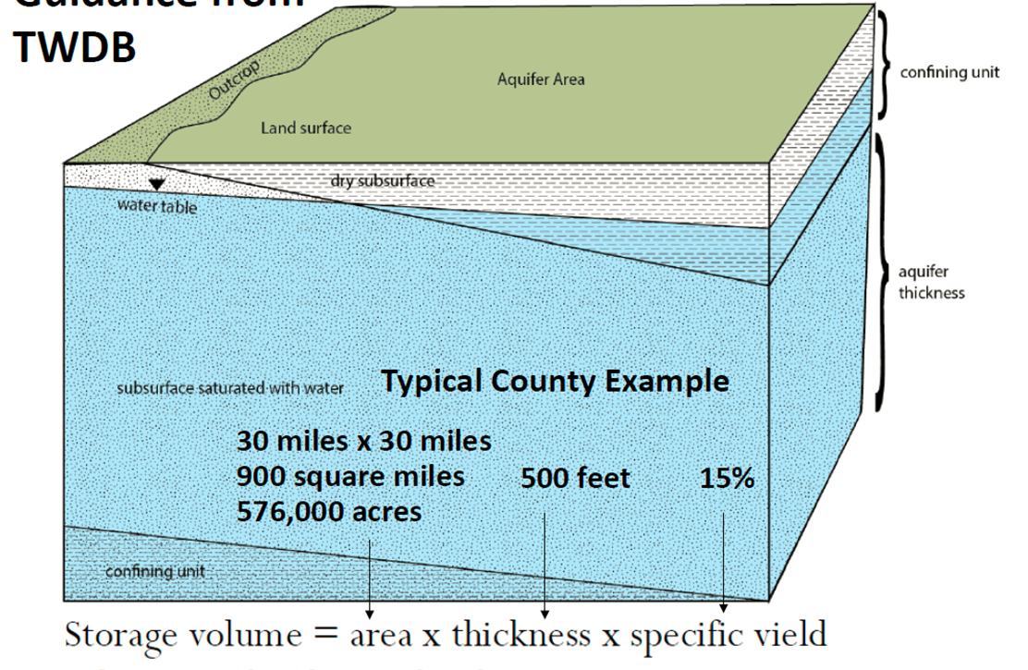
Groundwater in Storage
Confined Unit
Aquifer Thickness
Storage volume = area x thickness x drainable porosity

Slide 37
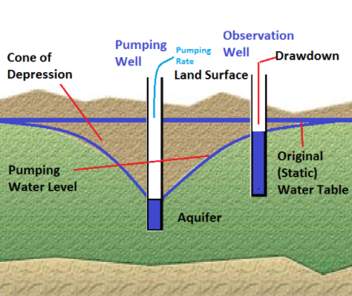
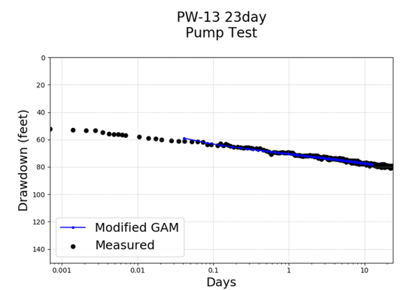
Production Capacity of Aquifer
Hydraulic Conductivity (ft/day)
Gravels | 100 to 1000
Sands | 1 to 50
Silts | 0.01 to 0.5
Clays | 1E-5 to 0.005
Transmissivity = K * B
K = hydraulic conductivity (ft/day)
B = aquifer thickness (ft)

Slide 38

Production Capacity in POSGCD

Slide 39
Approach for Establishing Maximum Production Volumes
Criteria for Aquifer
  Average Productive Capacity
  Average Thickness of Aquifer Across Permitted Acreage Determined by POSGCD
  Hydrogeologic Study Provided by Applicant
Aquifer Grouping
  Wilcox Aquifer (Hooper, Simsboro, Calvert Bluff)
  Carrizo
  Sparta
  Queen City
  Yegua Jackson

Slide 40


Productive Capacity Determined by POSGCD
Transmissivity in GAMs
Transmissivity in POSGCD Operational Model
Results from Pumping Tests
Sand thickness maps

Slide 41

Average Thickness of Aquifer
Aquifer Thickness in GAM and POSGCD Operational Model
Analysis of Geophysical Logs
Geophysical Logs Provided by Applicant

Slide 42
Example Framework for Proposed Approach
Aquifer Production Capacity
  Regulate Wilcox as one Aquifer
  Fix rate for lower capacity aquifer
Aquifer Thickness
  Wilcox rate determined by thickness each aquifer
  Outcrop and less than 250 feet thickness: minimum rate
  Confined with more than 700 ft thickness: maximum rate
Maximum Rate for all Aquifers across a permitted area is 2.5 acre-ft/acre
Maximum Production Allocation is increased if Total Dissolved Solids Concentration > 1,250 mg/L

Slide 43
Possible Implementation Approach
Engage Legal Counsel to Develop a Defensible Approach for Replacing the 2 acre-ft/acre at a Future Date or Event
  Date could be as great as 40 years into the future
  Event could be approaching a threshold for a DFC
Perform Study to Develop for Production Rates to be used for Initial Rule
  Consider investigating importance of nine factors used for setting DFCs
  Tied to conservation, preservation, and protection of groundwater resource
  Include stakeholder input and review

Slide 44
Compatibility of DFCs and PDLs

Slide 45
Discussed in Section 7.3.5 of Management Strategy Report
TWC Chapter 36.108 d (8)requires that GMA consider the feasibility of achieving the DFC
GMA 12 has historically used the GAM runs to demonstrates that DFCs are physical possible and compatible
Examination of the GAM Rules have demonstrated that PDL are exceeded prior to exceeding a DFC for every aquifer

Slide 46


Simulated DFC for PS-7
PS-7 Simulation
Comparison of PS-7 Simulated DFCs and POSGCD DFCs*
* From GMA 12 Sept 2019 presentation (note: different time periods for PS-7 and POSGCD DFCs)
By 2070, DFCs are exceeded for Carrizo, Calvert Bluff, Simsboro, and Hooper Aquifers

Slide 47

Simulated Average Drawdown for Aquifer Depth of 400 feet (simulated PDL)

Slide 48




Sensitivity to Depth of Shallow Zone
~water table
300 ft
200 ft
400 ft

Slide 49
Summary
Examination of GMA 12 P-7 Run Shows that PDLs of 20 feet are exceeded more than 30 years before DFCs are exceeded for the Carrizo, Calvert Bluff, Simsboro and Hooper Aquifers
PDLs were originally develop to protect the saturated thickness of the outcrop areas and specifically the decrease in the water table level
The change in the hydraulic head associated with the middle to lower portion of the aquifer outcrop is a viable substitute for a PDL

Slide 50
Update on GMA 12 Joint Planning

Slide 51
Summary of GMA Activities
Modeling Activities for 2022
  Develop approach to estimate production for exempt pumping
  Construct database for production from permitted pumping
  Construct baseline pumping file for exempt and permitted wells
Meetings for 2022
  Bimonthly
  Discussions related to Chapter 36 issues

Slide 52

QUESTIONS ?
Questions ?

