Slide 1
Effects of Simulated Pumping on BVGCD Permitted and Registered Simsboro Wells
612 BVGCD permitted and registered Simsboro wells
Assessment does not allocate responsibility for impacts among all the groundwater
producers in the Simsboro Aquifer.
Timing and magnitude of pumping have potential impacts on allocation of responsibility
and on when and if wells may require mitigation.
Analysis compares the simulated water level elevation in 2059 to well construction and pump data (as available or estimated) and estimates whether a pump will need to be lowered or whether a well will need to be redrilled based on that single estimate of water level elevation.
Analysis does not include age of wells, depreciation of wells and pumps, or standard
maintenance and pump replacements.
Analysis is preliminary and limited.
14

Slide 2
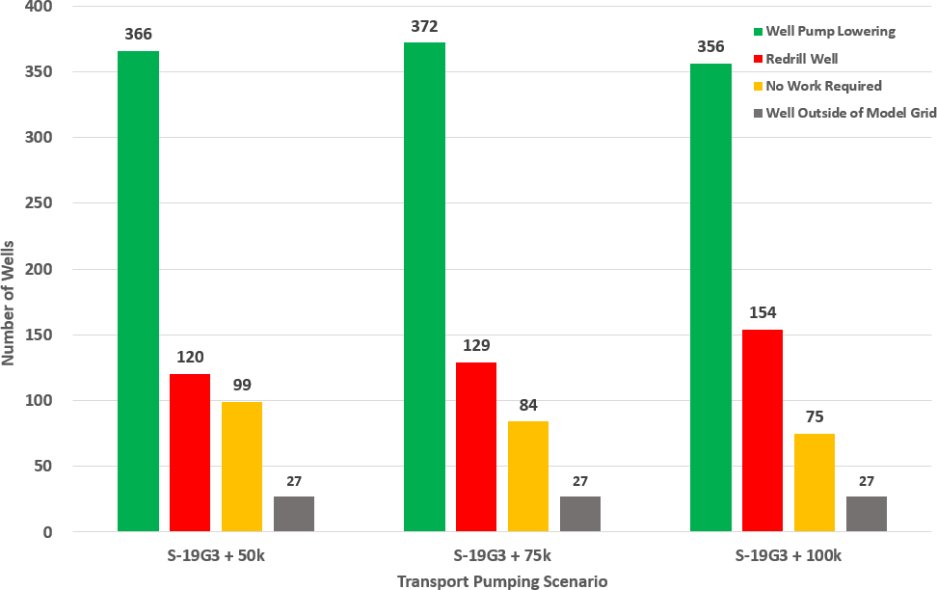
AGS Estimate of the Number of BVGCD Permitted or Registered Simsboro Wells that will need to be
Redrilled or have the Pump Lowered Based on All Pumping and Simulated 2059 Water Levels
50k
75k
100k
612 BVGCD Permitted and Registered Simsboro Wells Reviewed
15

Slide 3
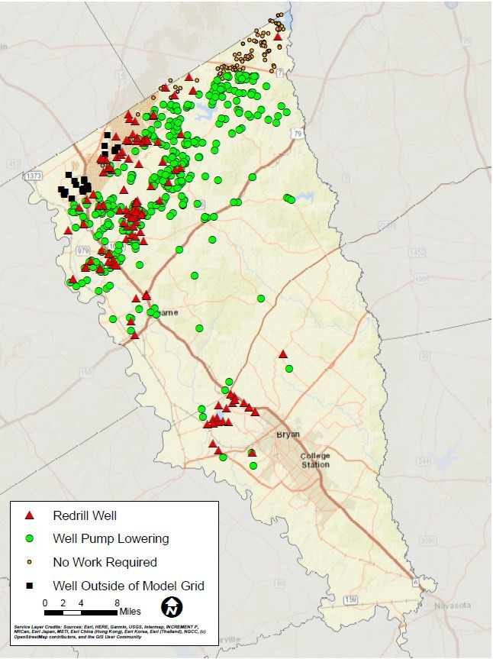
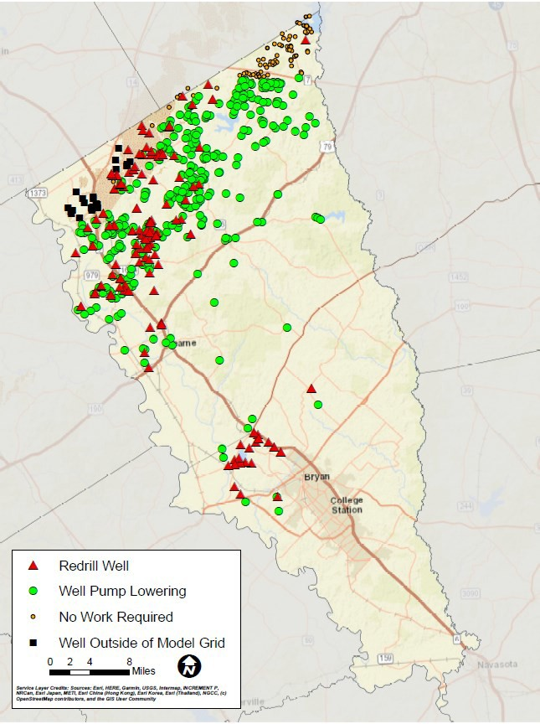
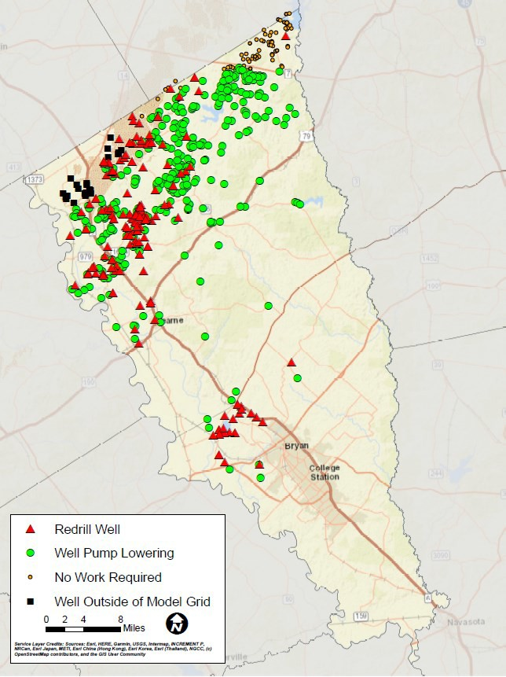
AGS Estimate of the Locations of BVGCD Permitted or Registered Simsboro Wells that will need to be
Redrilled or have the Pump Lowered Based on All Pumping
50K
75K
100K
50K - UWBVF wells under existing transport permit (BVTP-001)
75K - UWBVF wells under existing transport permit (BVTP-001) and the permitted wells in the transport permit applications
100K - UWBVF wells under existing transport permit (BVTP-001) and the permitted wells in the transport permit applications
16

