Slide 1

Expressing the Desired Future Condition

Slide 2
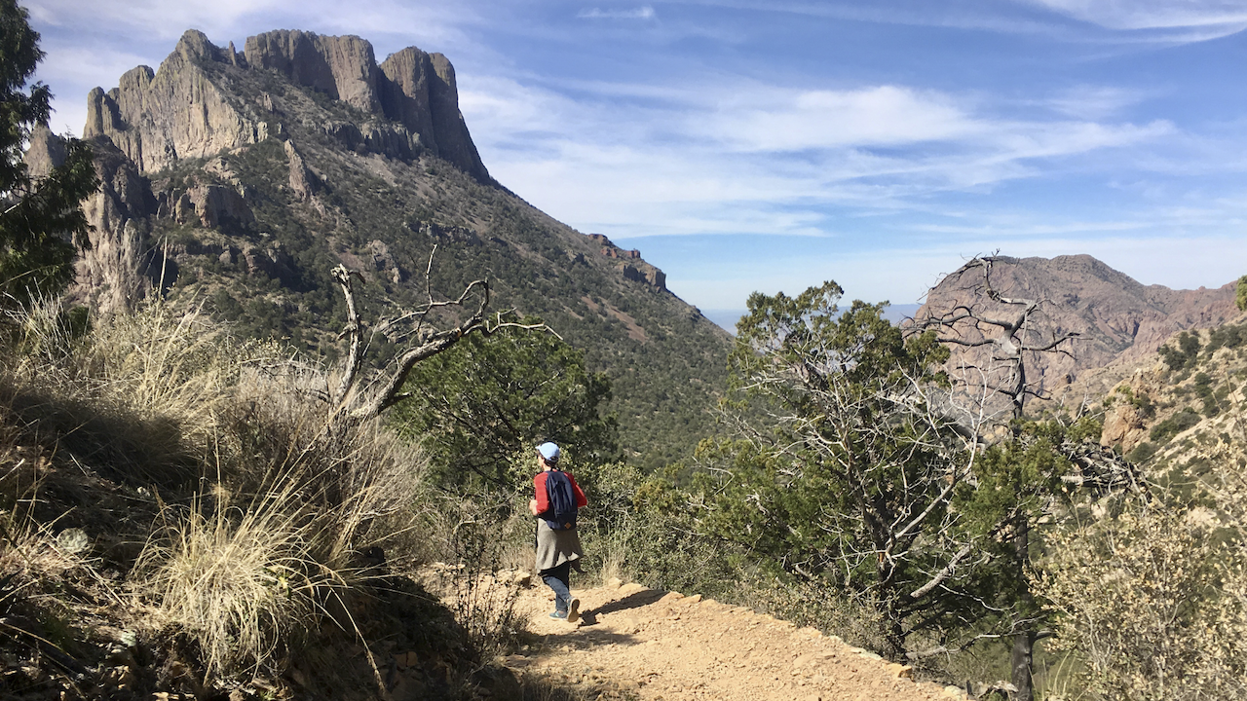

Slide 3
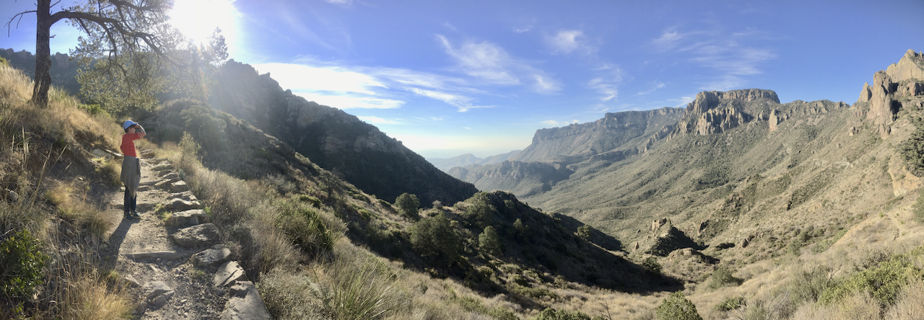

Slide 5
Which expression is more helpful?
In the next 50 seconds you will walk an average
of 150 feet toward the cliff.

Slide 6
Which expression is more helpful?
In the next 50 seconds you will walk an average
of 25% of the distance to the cliff.

Slide 7
Which expression helps you decide if you want to keep walking toward the edge?
In the next 50 seconds you will walk an average
of 150 feet toward the cliff.
of 25% of the distance to the cliff.

Slide 8
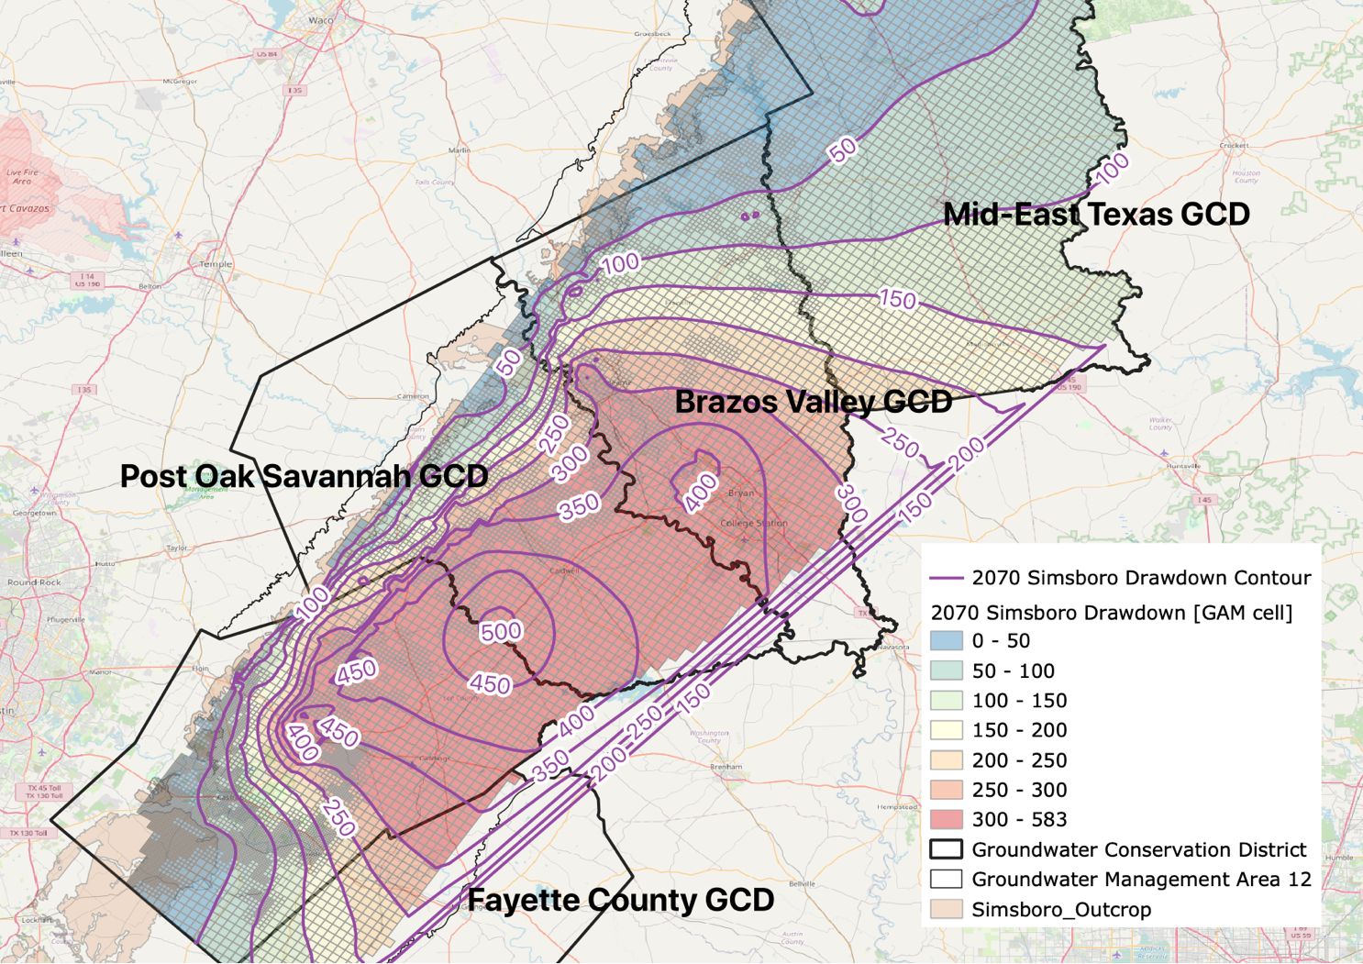
Desired Future Condition
Expressed as
Average Drawdown
across the
District
2070 DD - Simsboro Formation
Avg DD = 79 ft
Avg DD = 198 ft
Avg DD = 281 ft
Lost Pines GCD
Avg DD = 158 ft
Avg DD = 209 ft

Slide 9
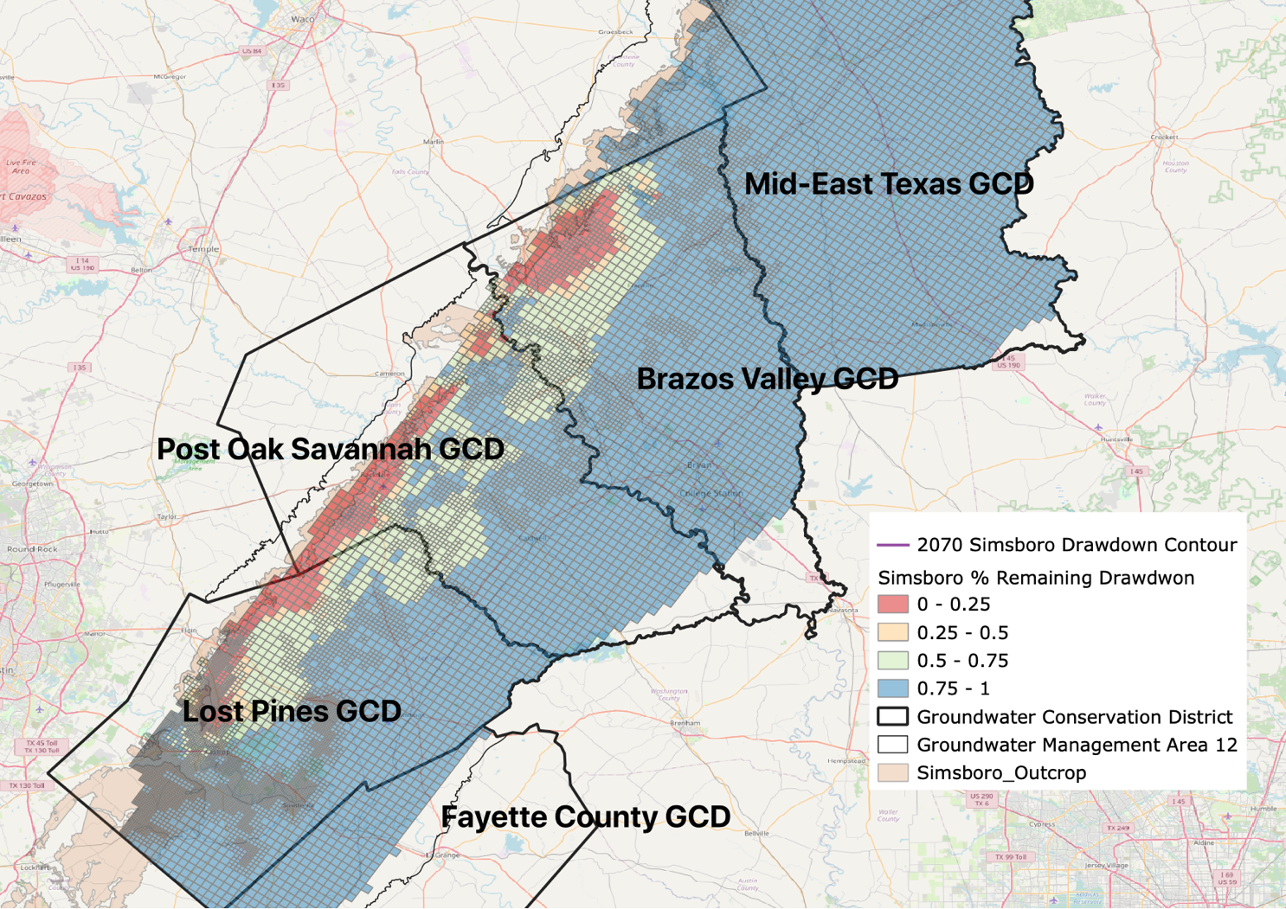
Desired Future Condition
Expressed as
Average Precent of Remaining Drawdown [PRDD]
2070 DD - Simsboro Formation
Avg PRDD = 95%
Avg PRDD = 73%
Avg PRDD = 68%
Avg PRDD = 77%
Avg PRDD = 95%

Slide 10
Other factors to incorporate
Springs & seeps cannot be mitigated like a water well.
  How can the DFC expression support the use of Management Zones by a GCD to conserve surface waters?
??

