Slide 1
Yegua-Jackson Aquifer
presented to GMA12
February 21, 2025

Slide 2
Presentation Outline
Where are we?
Aquifer extent and description
2022 TWDB pumpage estimates
Values from last round of planning
Proposed/Potential path forward

Slide 3
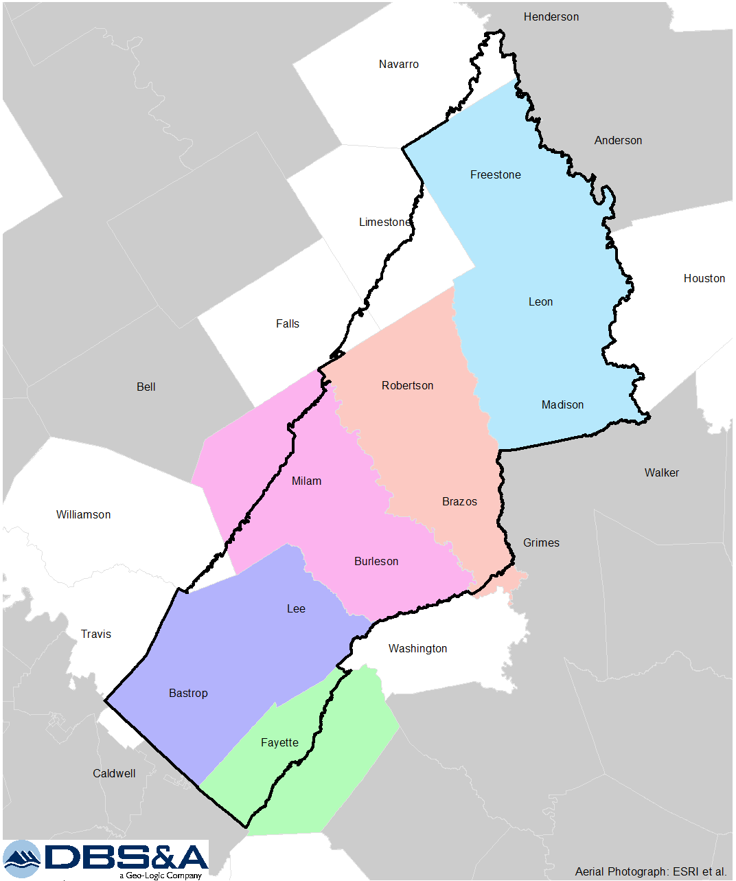

Slide 4
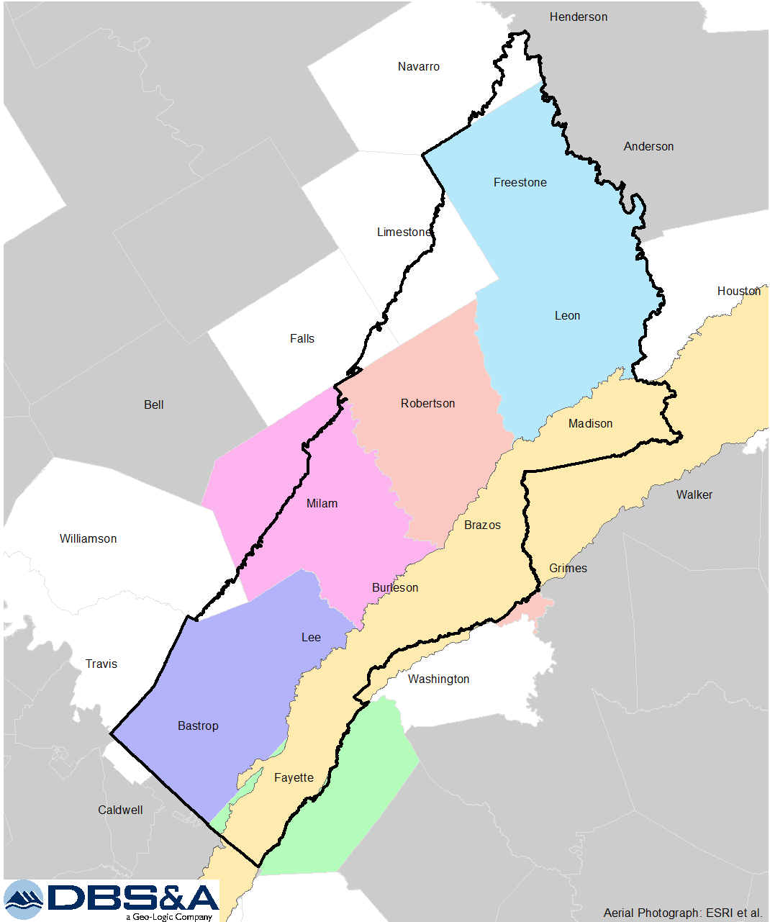

Slide 5
“The Yegua-Jackson Aquifer is a minor aquifer stretching across the southeast part of the state. It includes water-bearing parts of the Yegua Formation (part of the upper Claiborne Group) and the Jackson Group (comprising the Whitsett, Manning, Wellborn, and Caddell formations). These geologic units consist of interbedded sand, silt, and clay layers originally deposited as fluvial and deltaic sediments. Freshwater saturated thickness averages about 170 feet.”
Source: https://www.twdb.texas.gov/groundwater/aquifer/minors/yegua-jackson.asp

Slide 6
Variable water quality
Uses include domestic, livestock, industrial, irrigation, and municipal
Area of aquifer: 10,932 square miles
Proportion of aquifer with groundwater conservation districts: 62 percent
Number of counties containing the aquifer: 34
Source: https://www.twdb.texas.gov/groundwater/aquifer/minors/yegua-jackson.asp

Slide 7
2022 TWDB Pumpage Data
Pumping (ac-ft/yr) | Mid-East Texas GCD | Brazos Valley GCD | Post Oak Savannah GCD | Lost Pines GCD | Fayette County GCD
Municipal | 108 | 23 | 298 | 27 | 1,387
Mining | -- | -- | 577 | 370 | 601
Livestock | 118 | 220 | 116 | 36 | 154
Irrigation | -- | 1,270 | 63 | -- | 181
Total | 226 | 1,513 | 1,054 | 433 | 2,323

Slide 8
Adopted DFC’s for 2021 Joint Planning
Groundwater Conservation District | DFC 2010 through 2069 Average Drawdown (ft)
Mid-East Texas | 8
Brazos Valley | 67
Post Oak Savannah | 61
Lost Pines | --
Fayette | 81
-- Declared non-relevant for purposes of joint planning

Slide 9
Comparison of 2022 Pumping (ac-ft/yr) to MAG
GCD | 2022 Total Pumping | Current Modeled Available Groundwater
 |  | 2020 | 2030 | 2040 | 2050 | 2060 | 2070
M-E Texas | 226 | 1,122 | 1,122 | 1,122 | 1,122 | 1,122 | 1,122
Brazos Valley | 1,513 | 4,207 | 6,270 | 7,092 | 7,091 | 7,091 | 7,091
Post Oak S. | 1,054 | 1,094 | 5,315 | 7,004 | 7,004 | 7,000 | 6,058
Lost Pines | 433 | -- | -- | -- | -- | -- | --
Fayette | 2,323 | 9,984 | 9,984 | 9,984 | 9,983 | 9,983 | 9,983

Slide 10
Potential (Proposed?) Approach
Update Model Run PS2 used in prior round of joint planning
Extend the model run to include additional 10 years (from Dec 2069 to Dec 2079)
For pumping use the values from the prior decade at the end of the simulation

Slide 11
END

